Slide 1
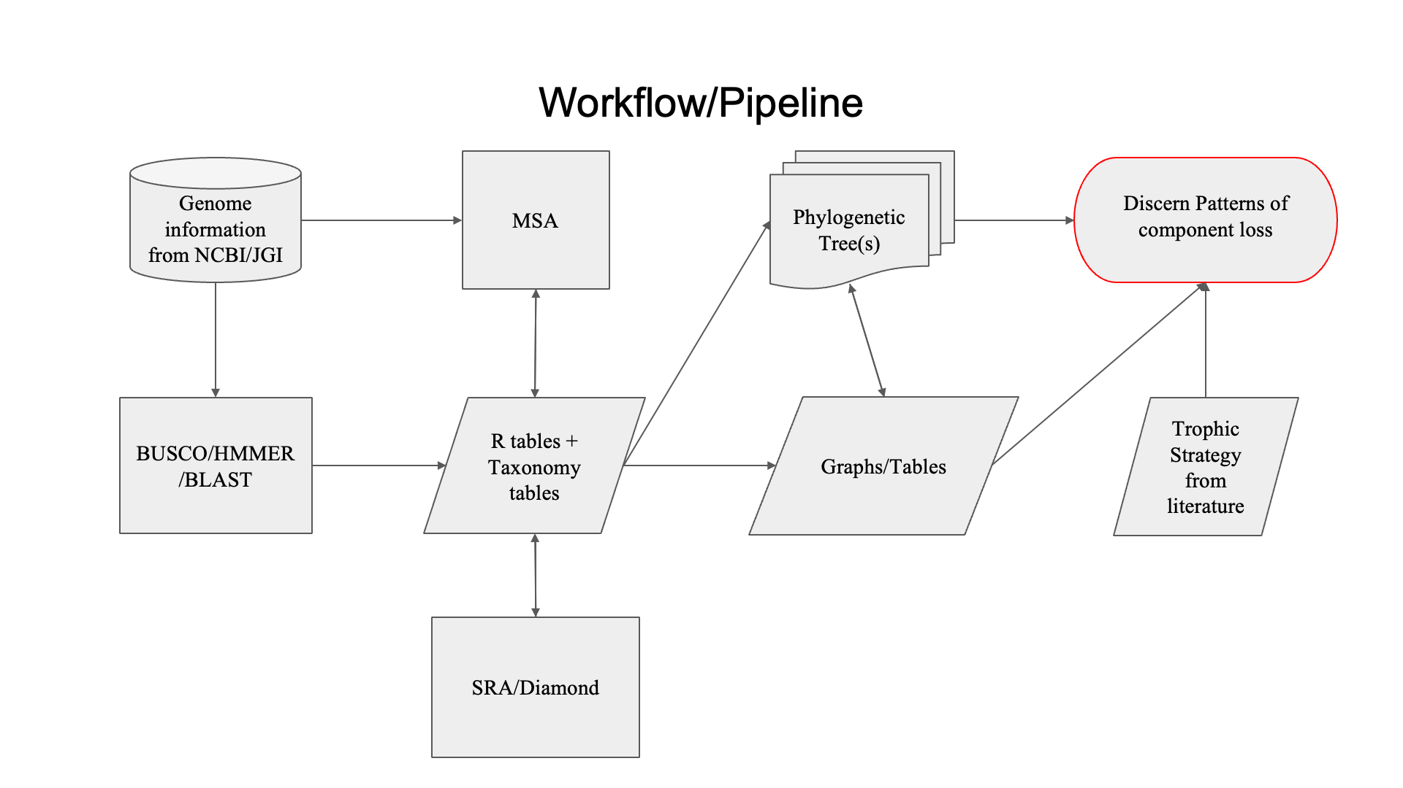


Figure 1

Slide 2
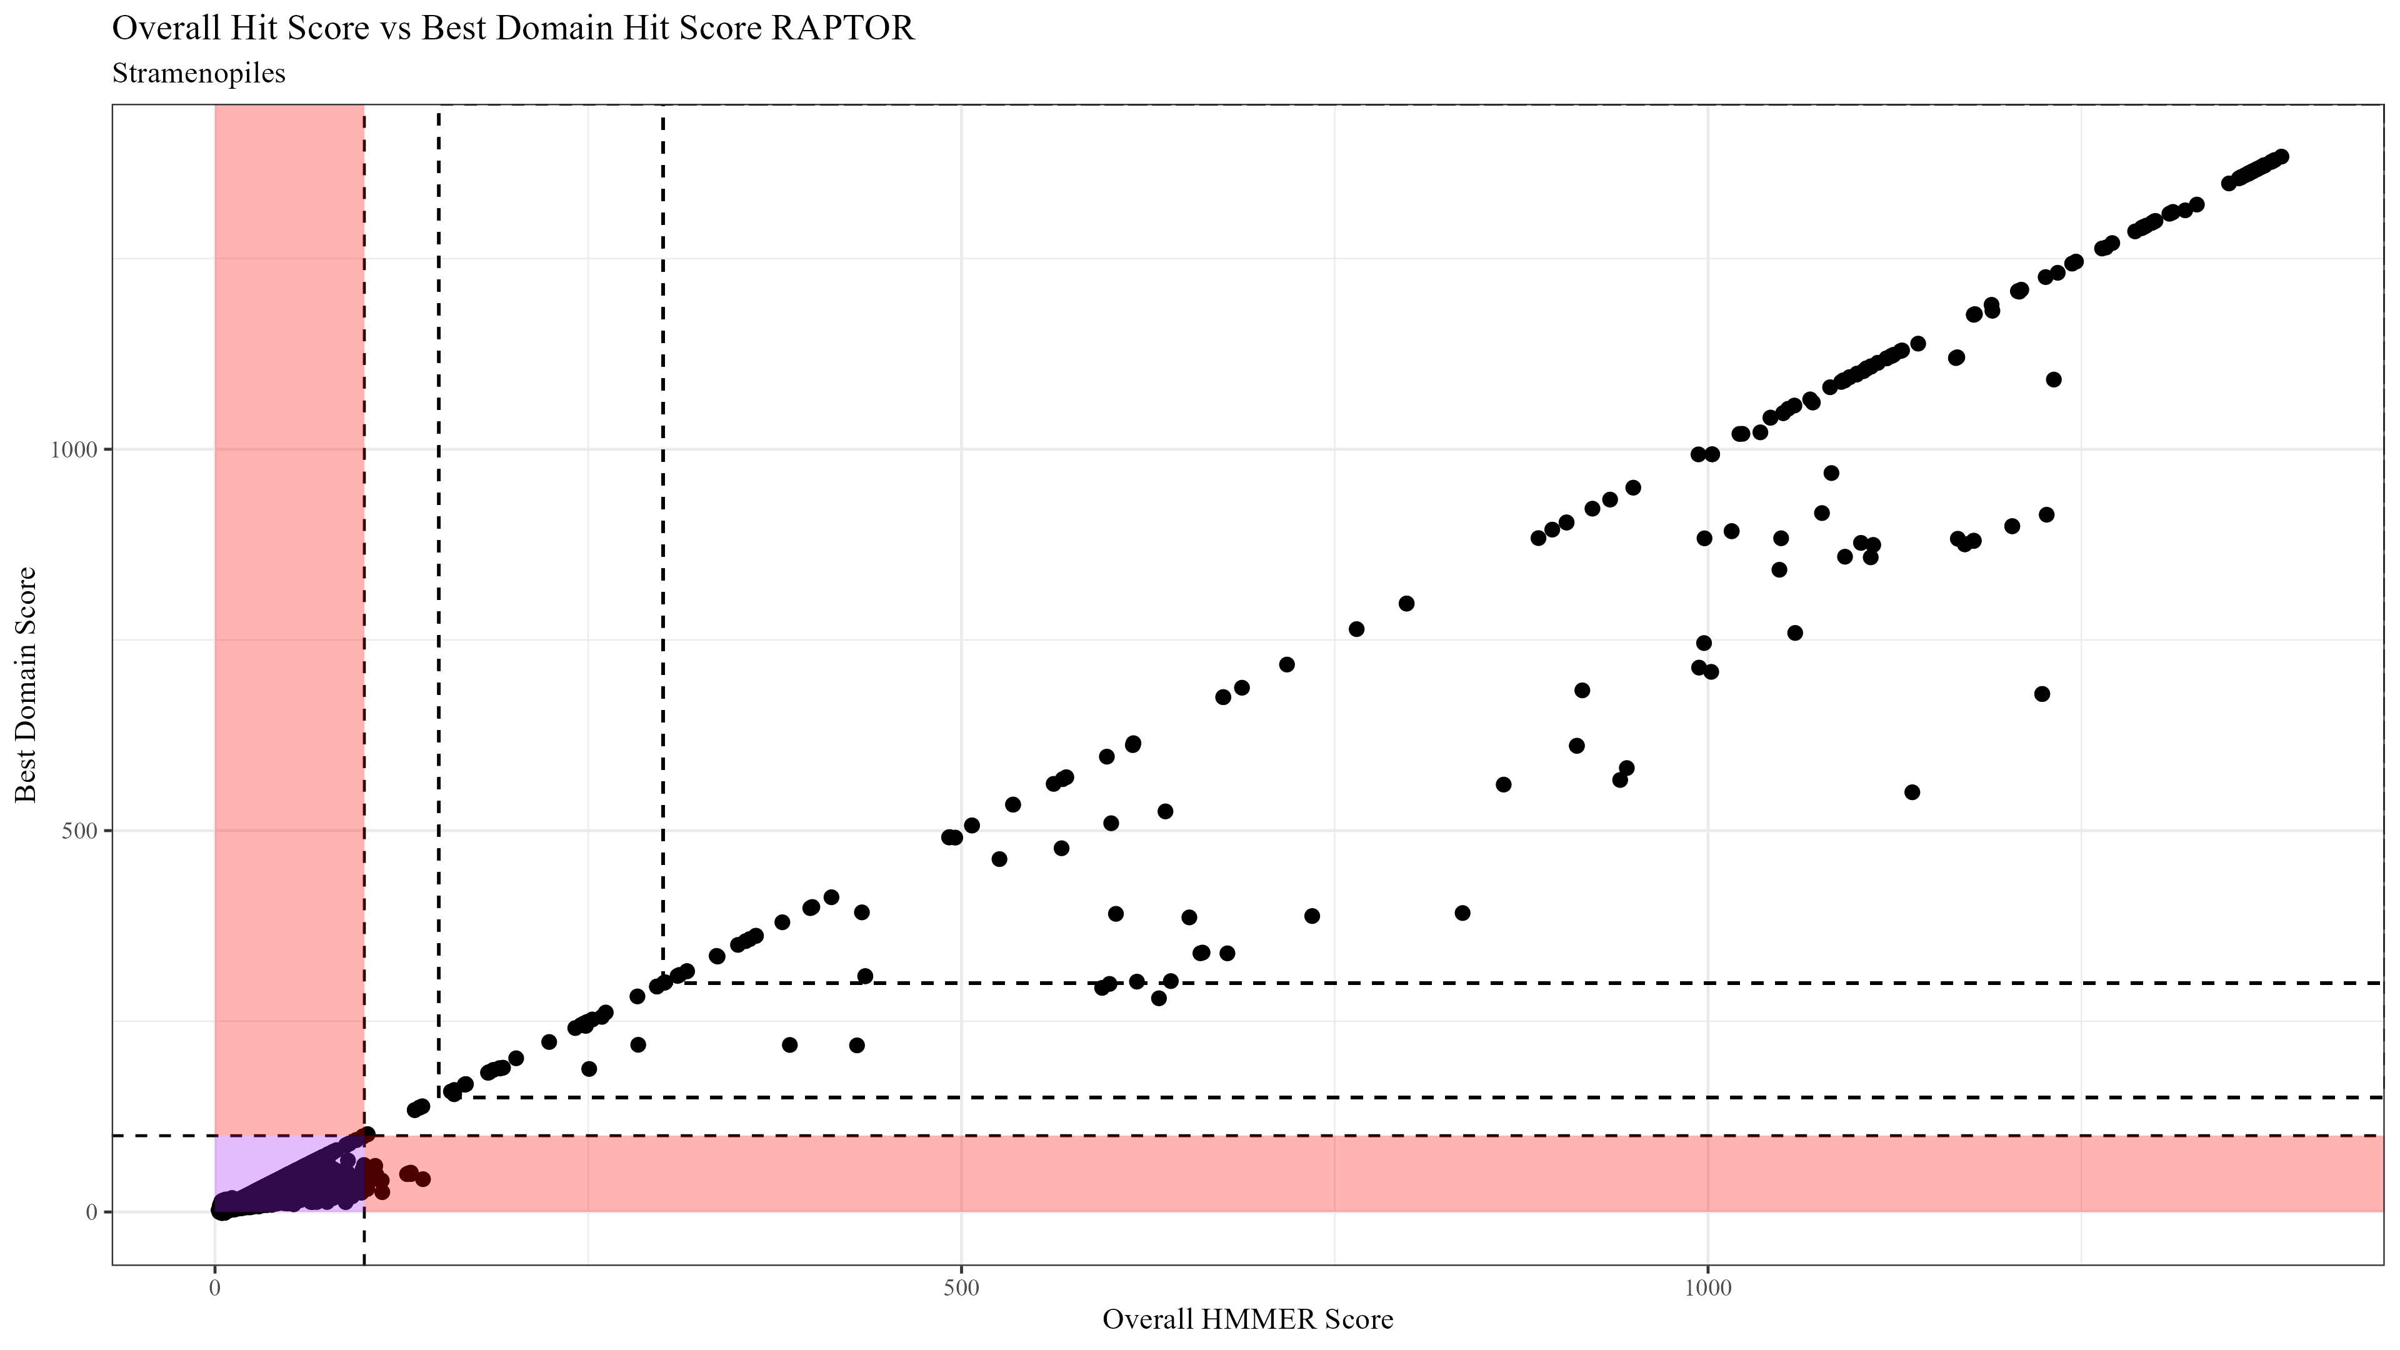
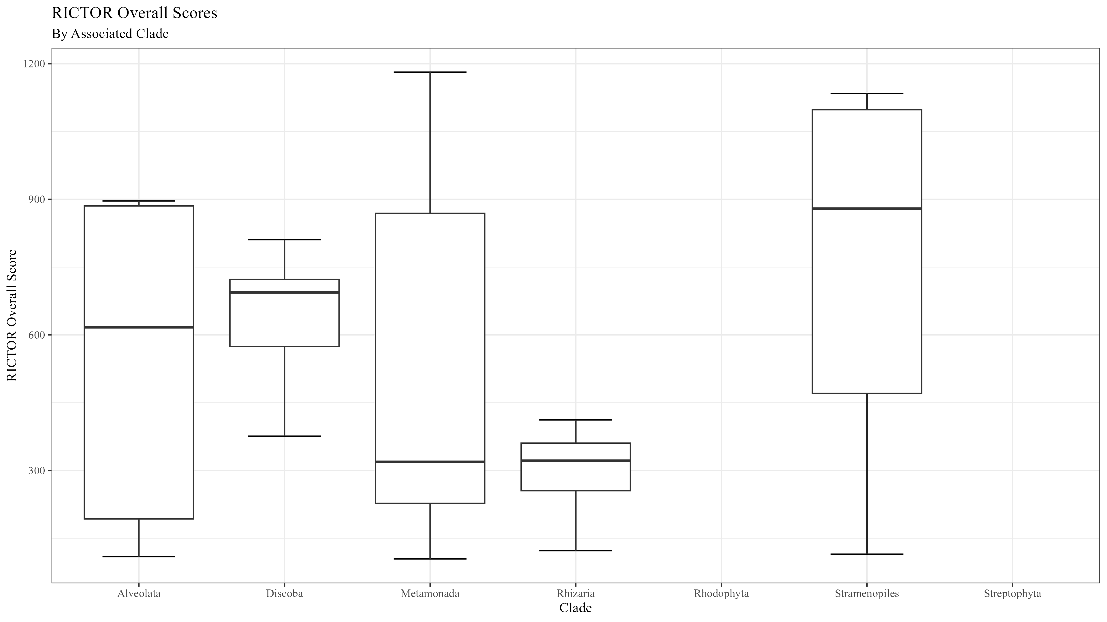
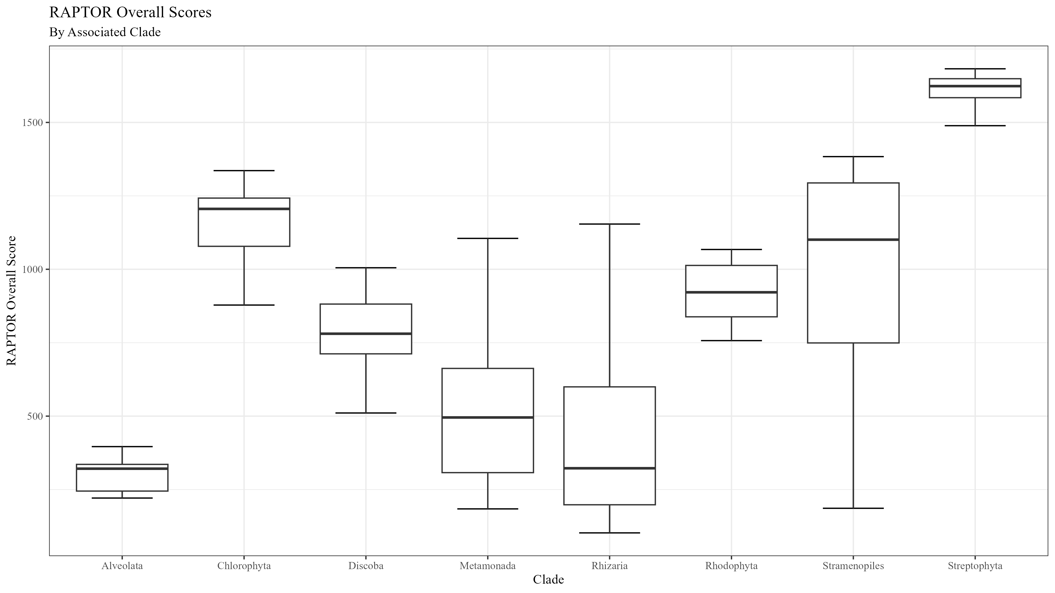
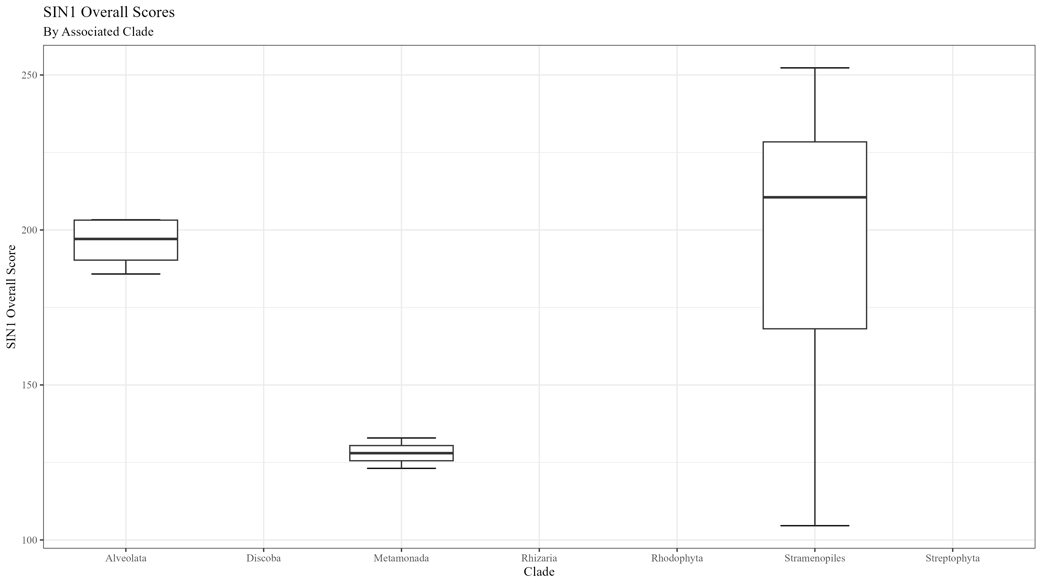
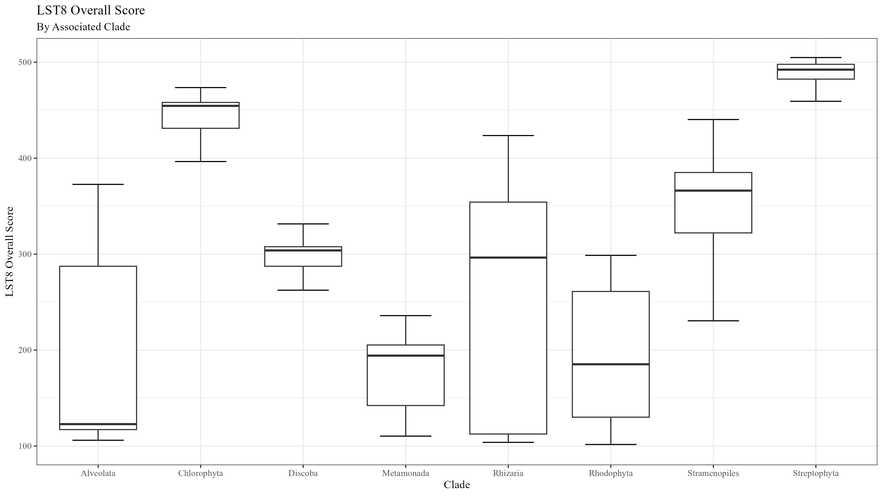

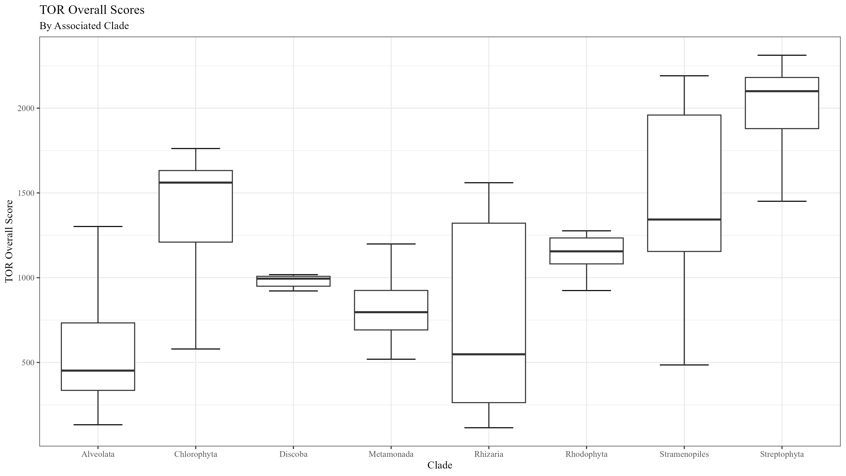
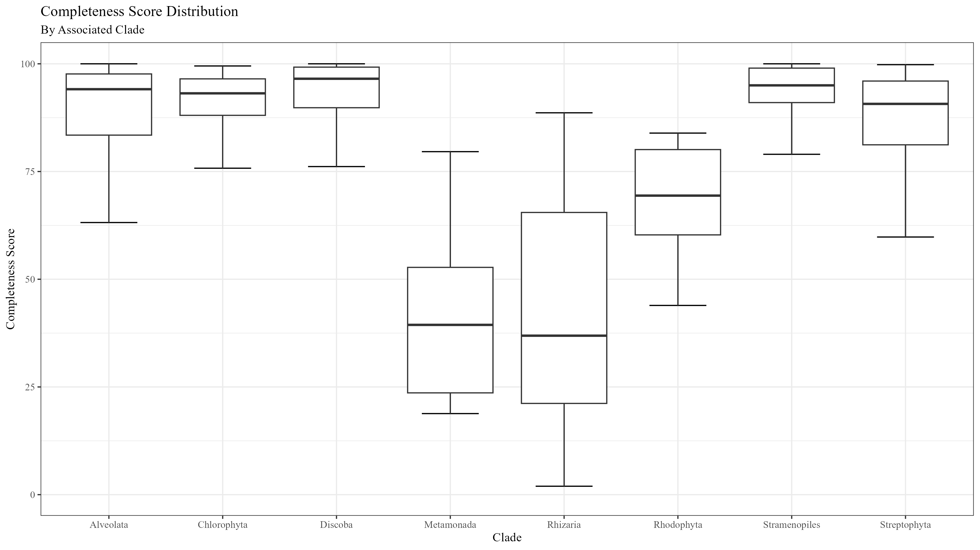
Figure 2

Slide 3
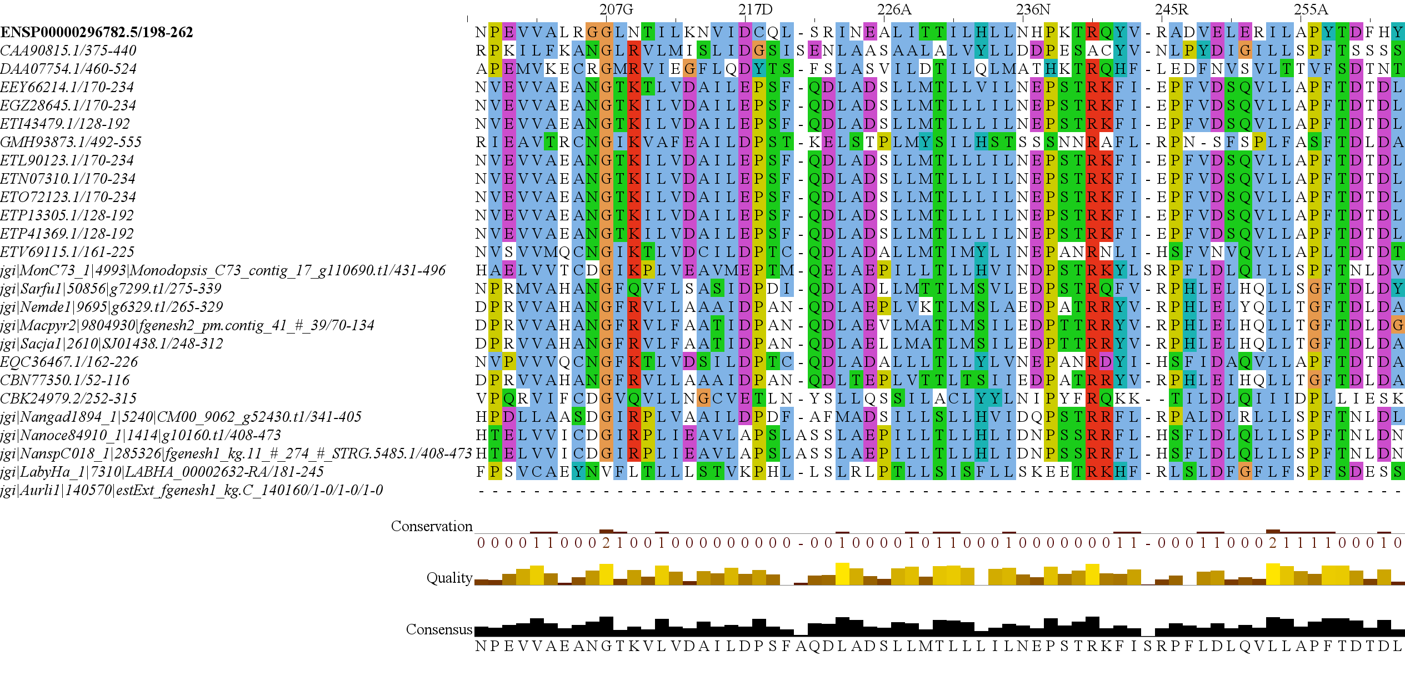
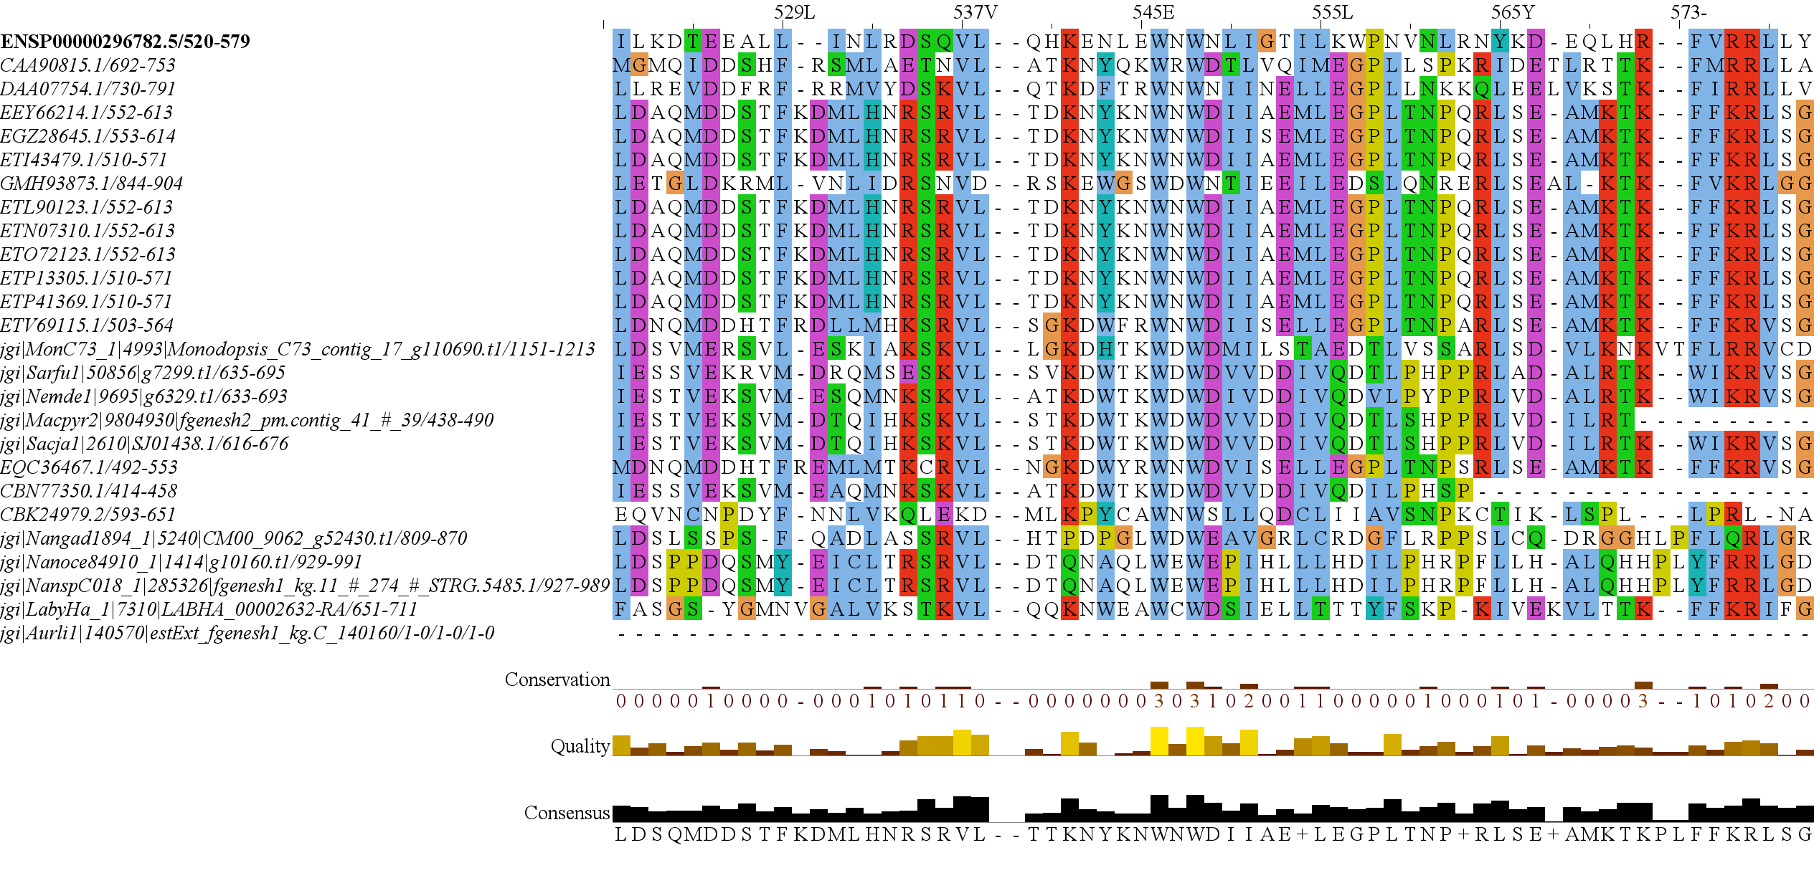
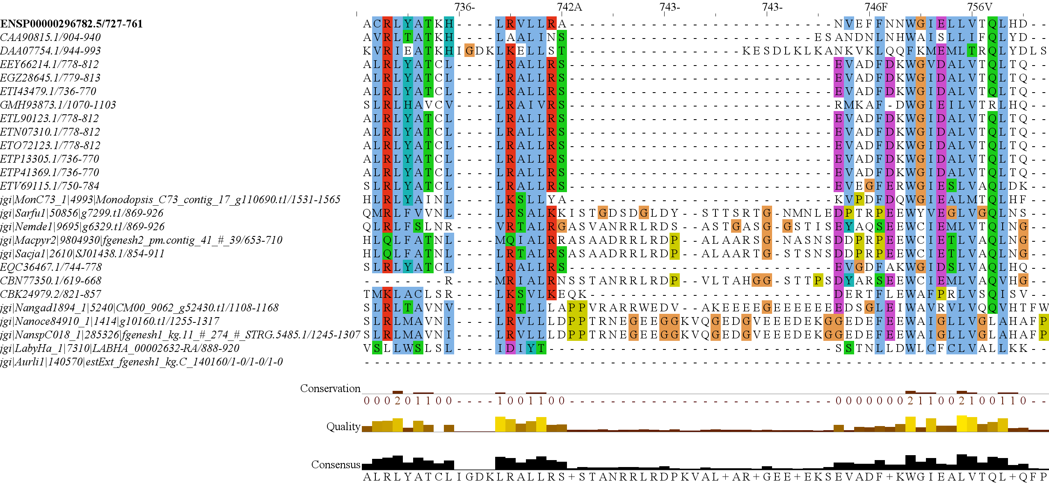
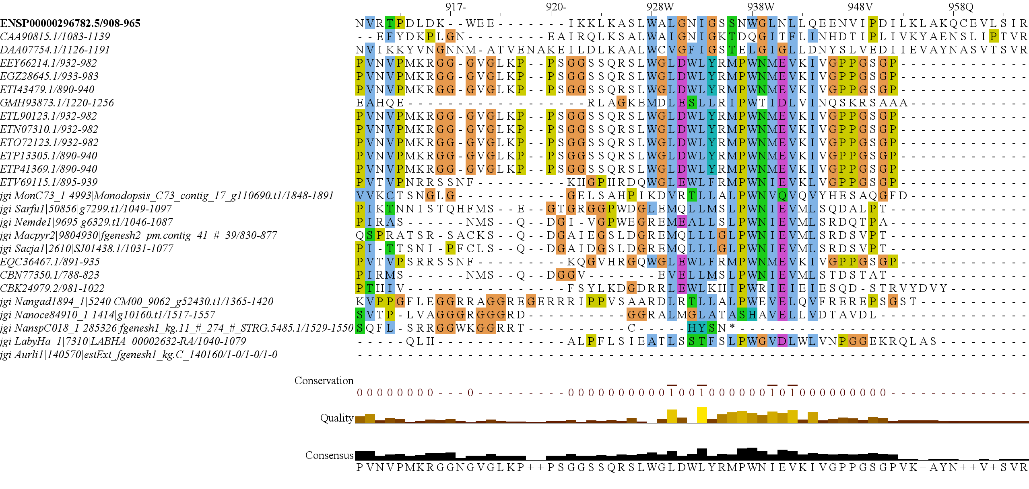
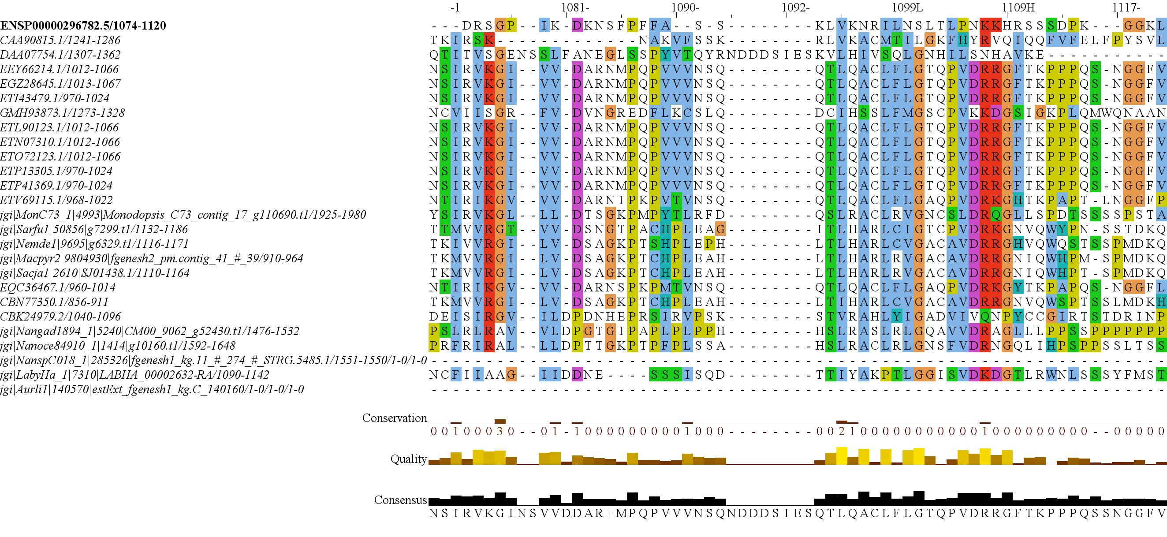
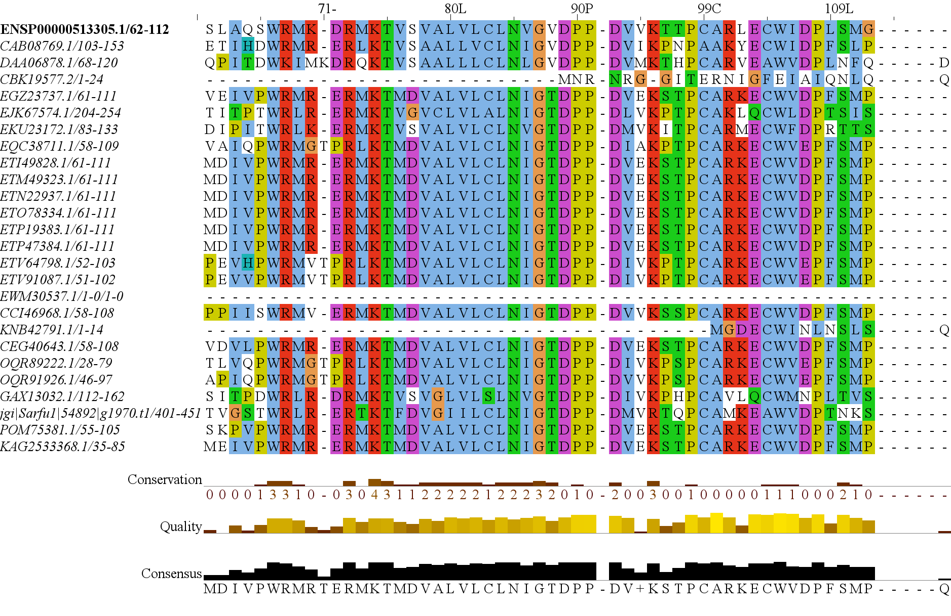
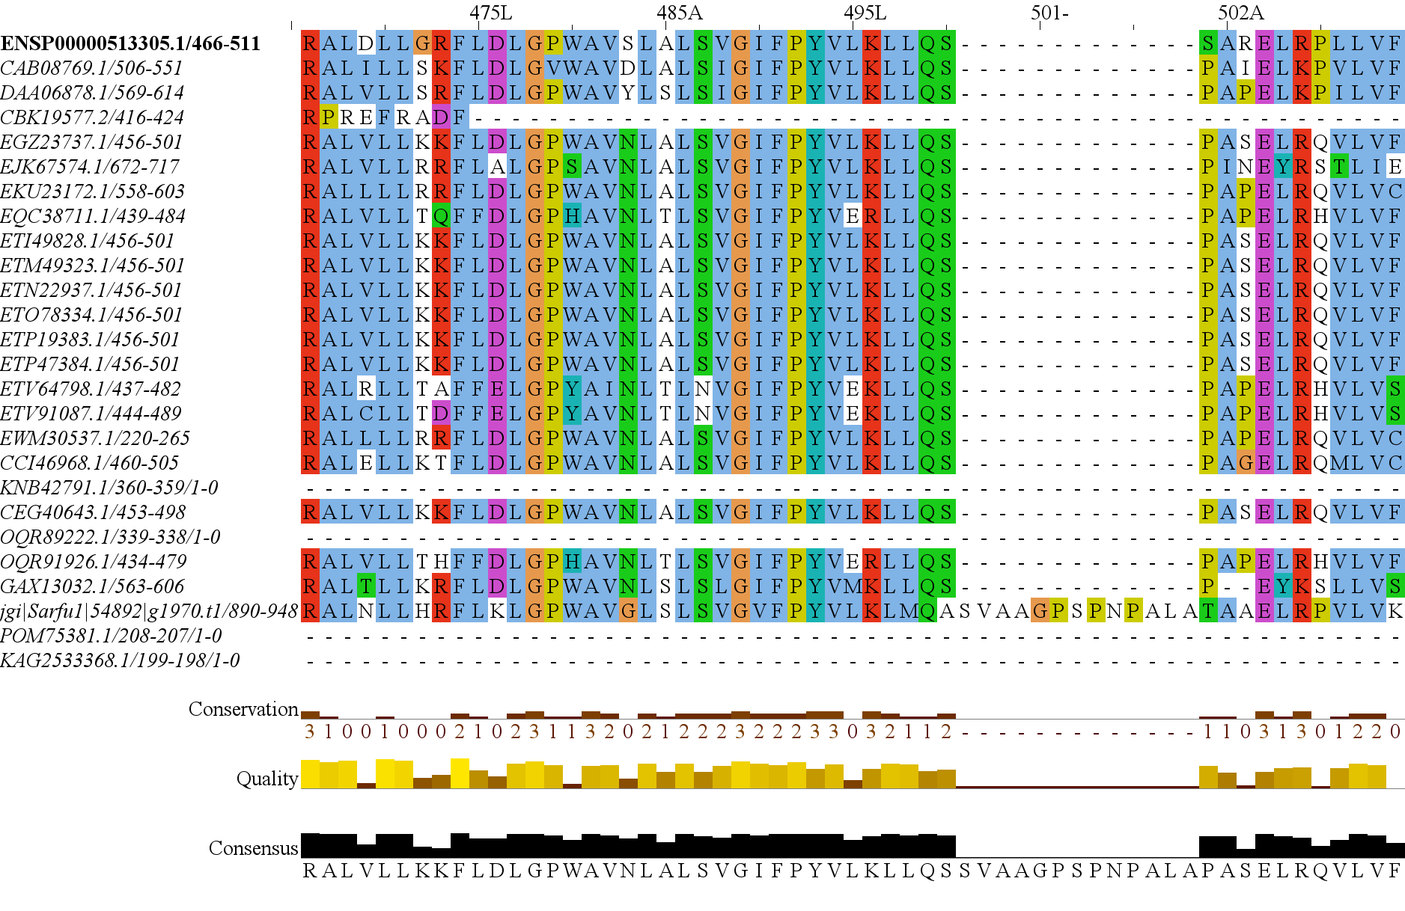
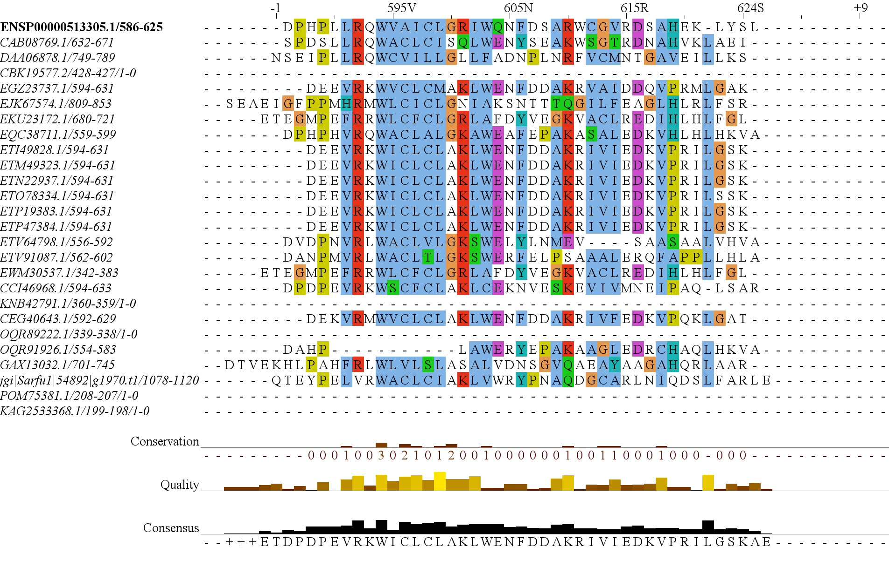
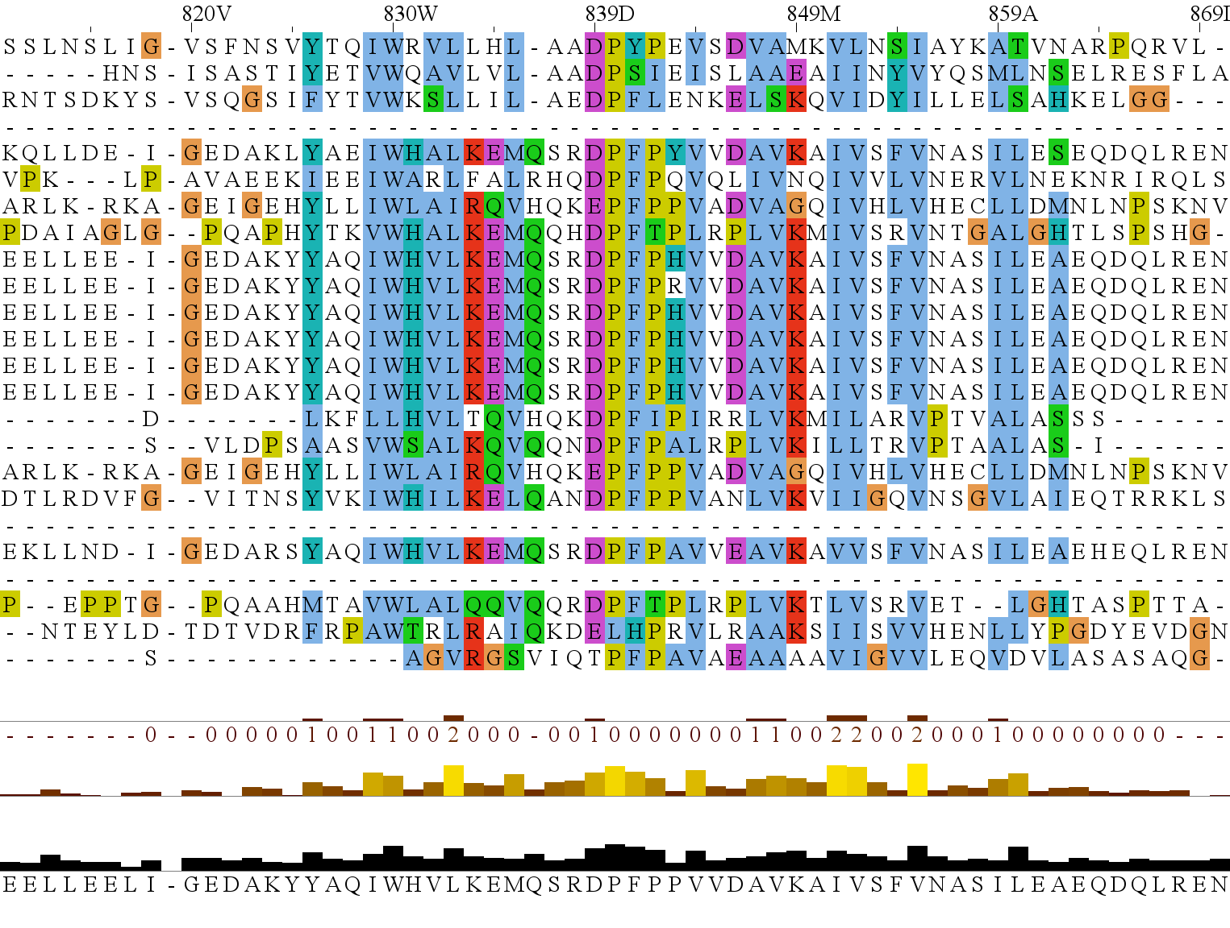
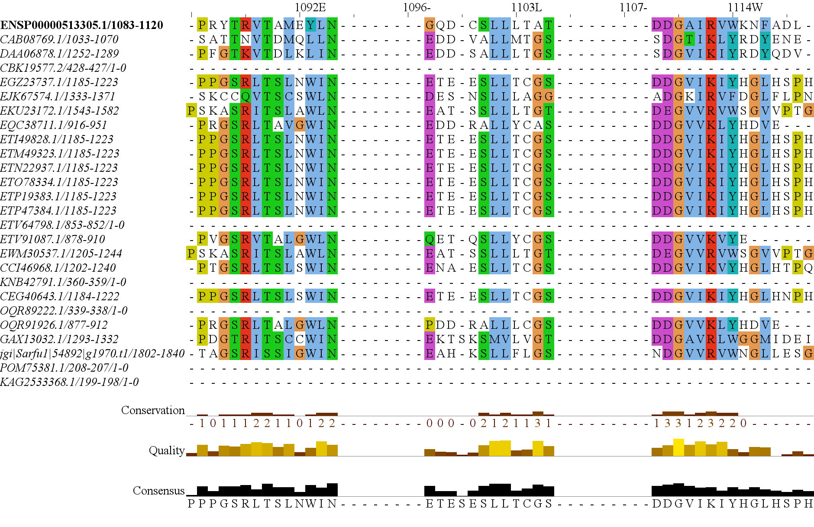
Figure 3
1
1694
RICTORN
RICTORM
RasGEF
Domain5
RICTOR Phosphorylation
ARM Repeats
Reference
High
Medium
Low
1
1353
RAPTORN
ARM Repeats
HEAT
ARM Repeats
WD-40 Repeats
Reference
High
Medium

Slide 4
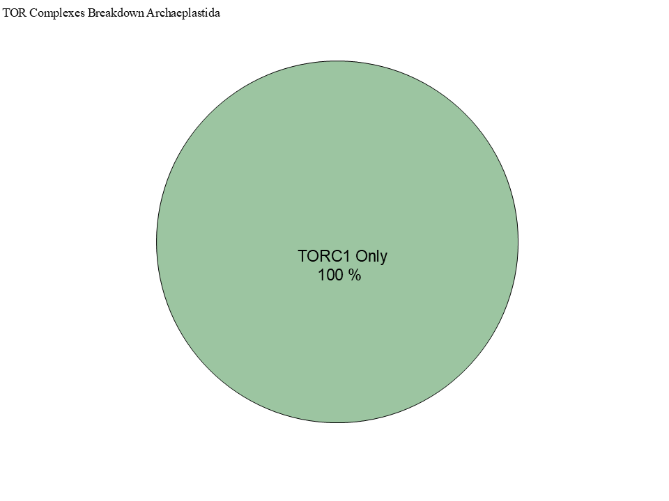
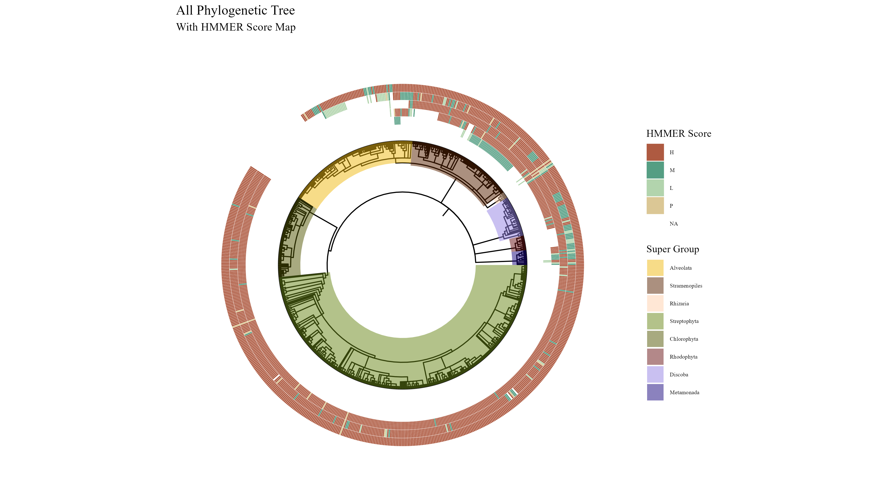
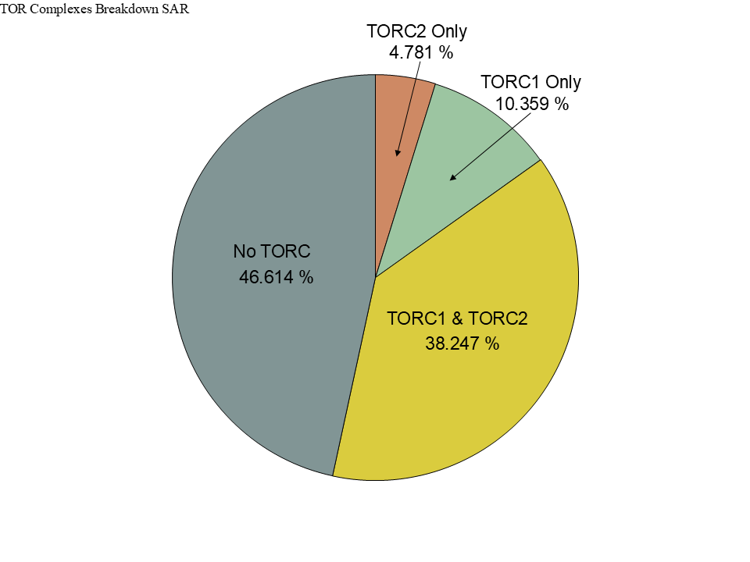
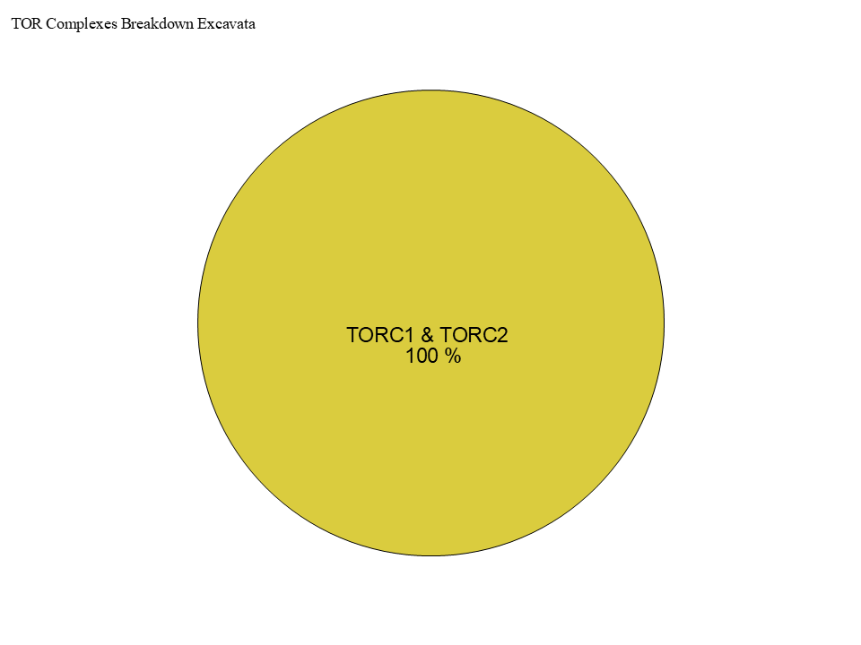
Figure 3
TOR
LST8
RAPTOR
RICTOR
SIN1

Slide 5
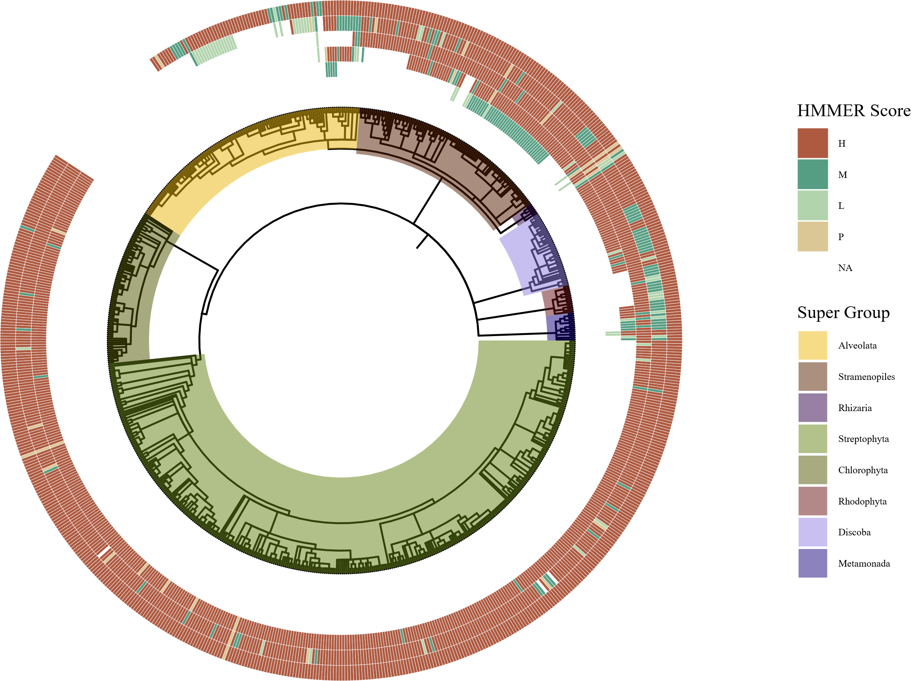
Figure 3
TOR
LST8
RAPTOR
RICTOR
SIN1

Slide 6
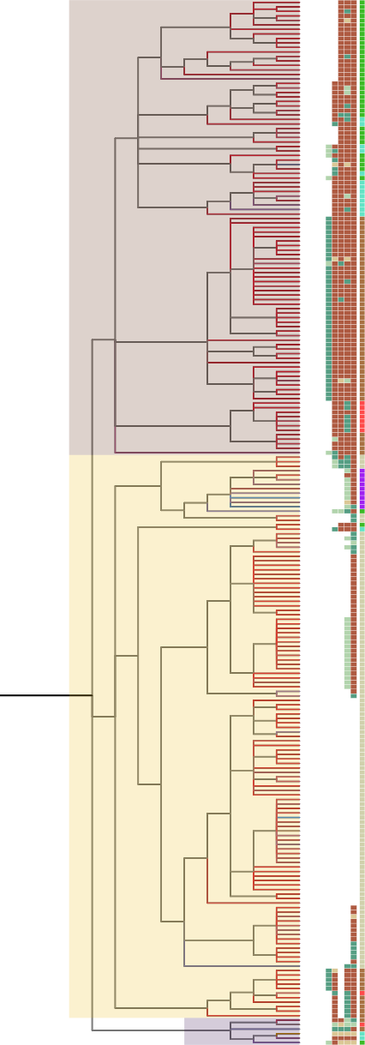
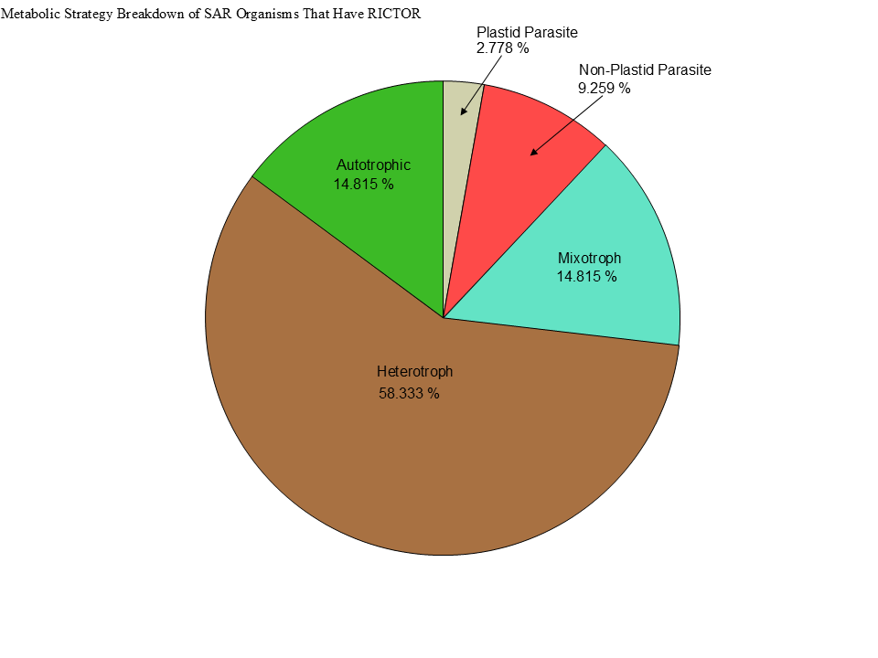
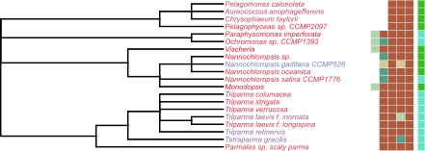
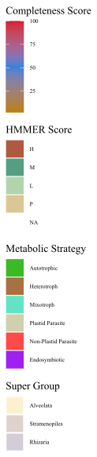
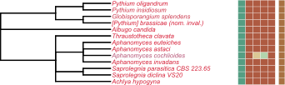
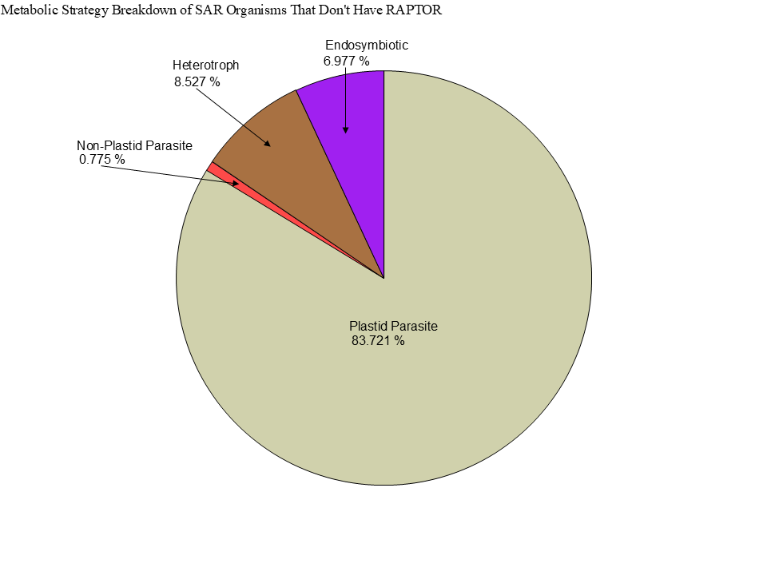
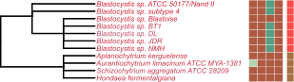
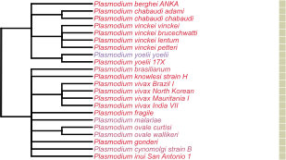
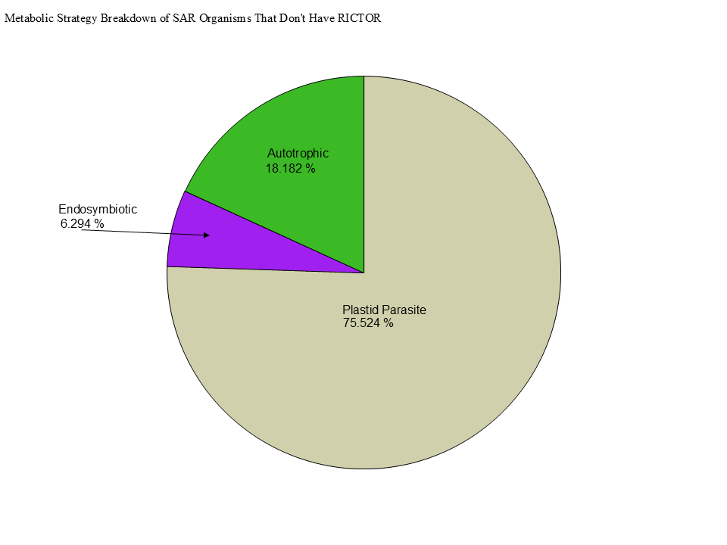
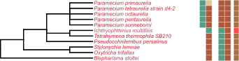
Metabolic Strategy
LST8
RICTOR
RAPTOR
SIN1
TOR
Stramenopiles
Alveolata
Rhizaria

Slide 7
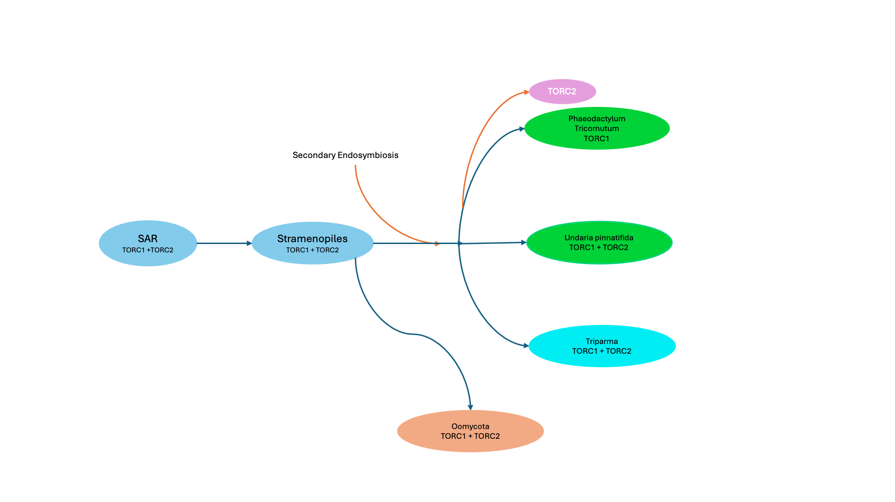

Slide 8
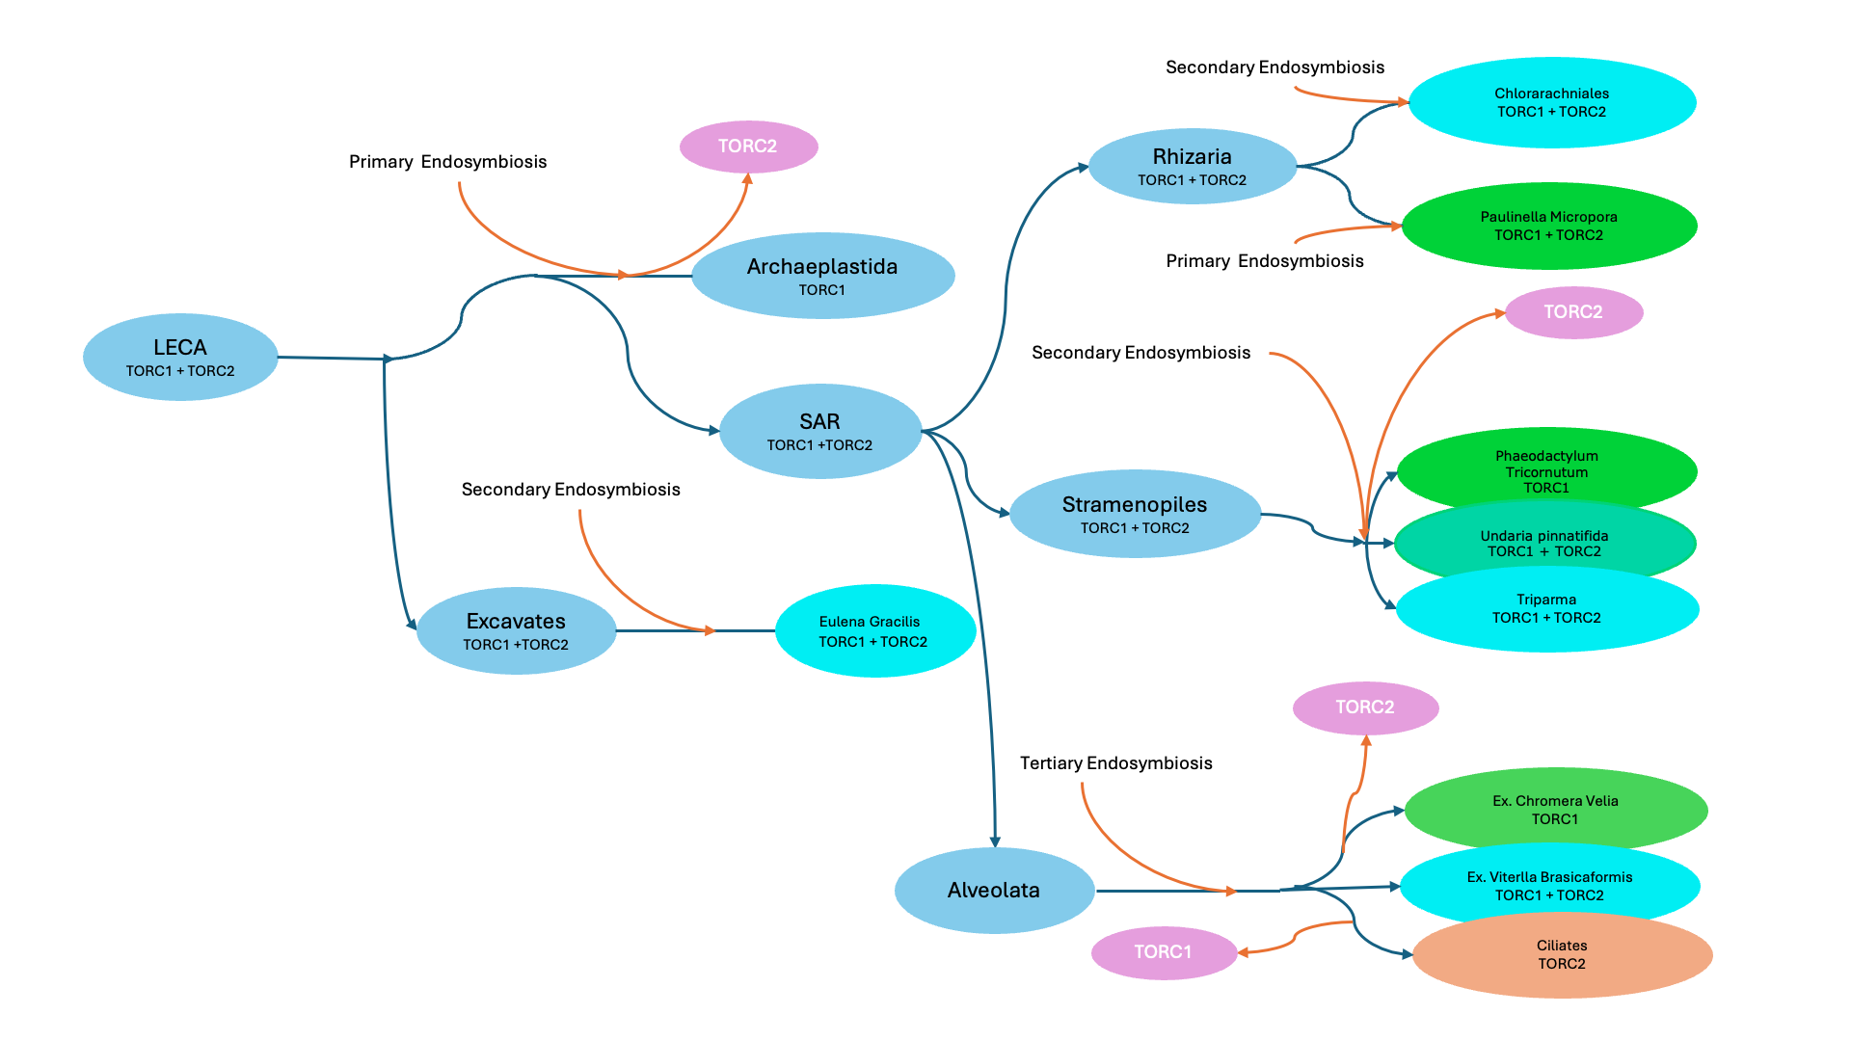
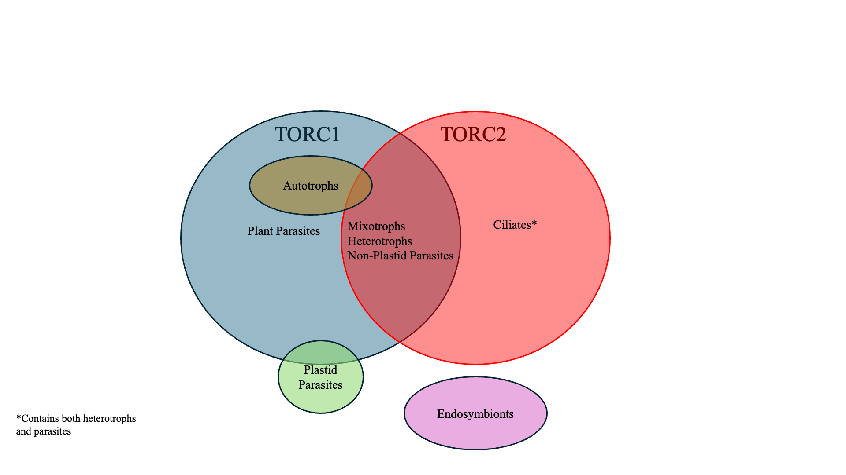

Slide 9

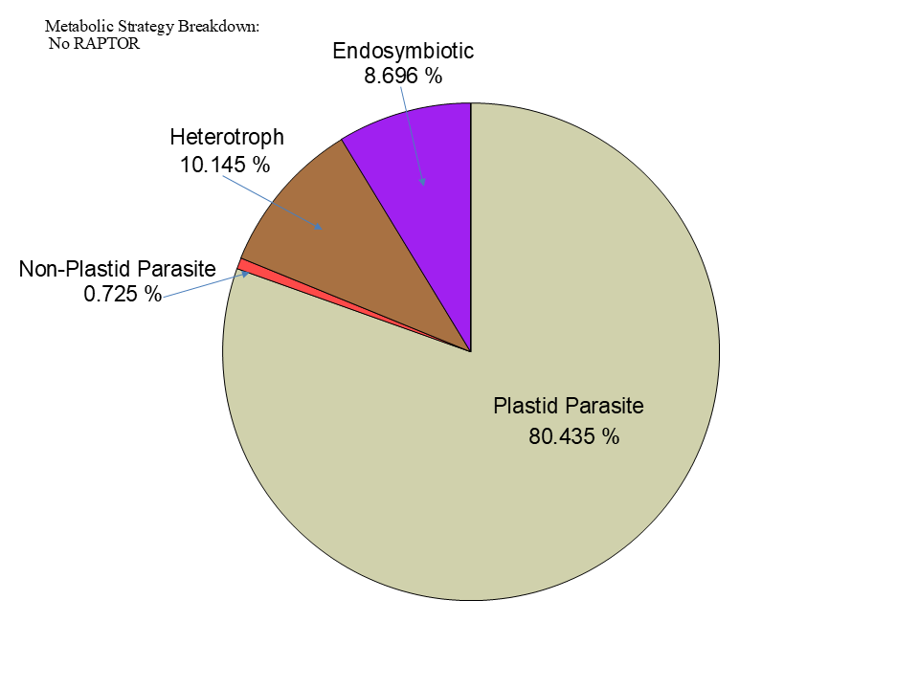

Figure 5

Slide 10
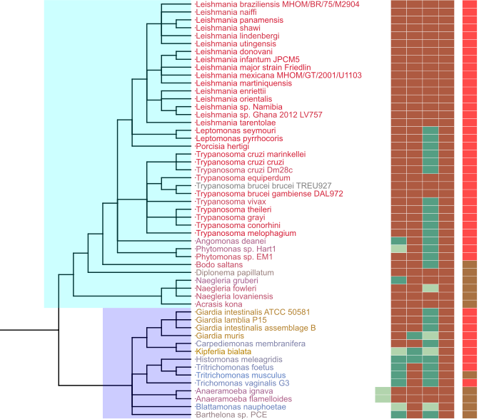
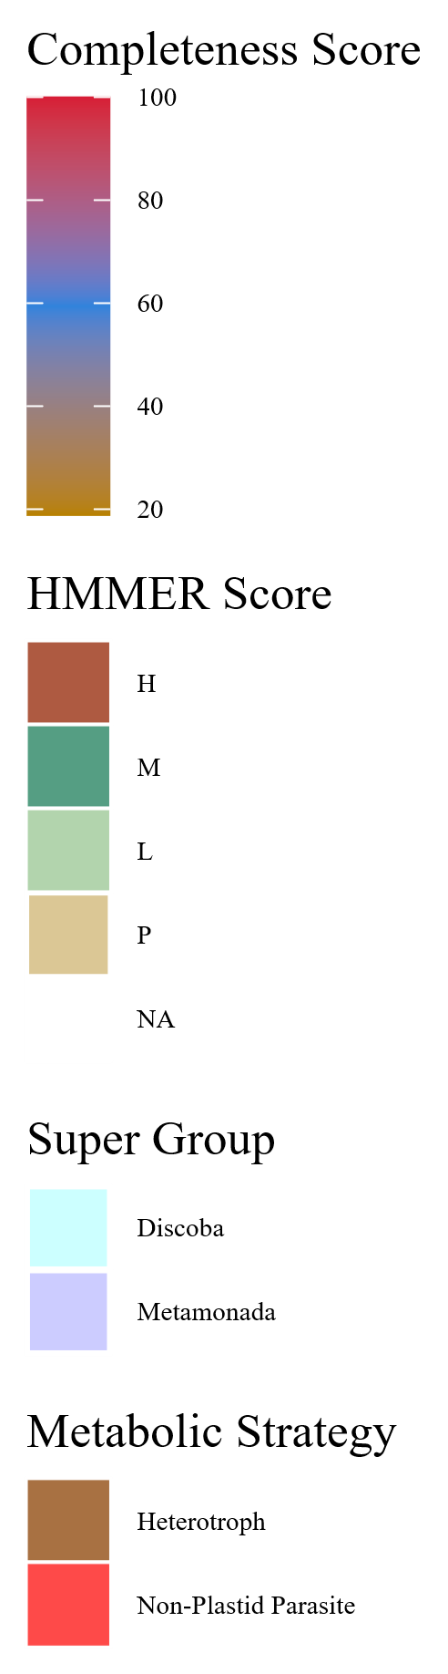
Figure 7
Metabolic Strategy
SIN1
RICTOR
RAPTOR
LST8
TOR
Discoba
Metamonada

Slide 11
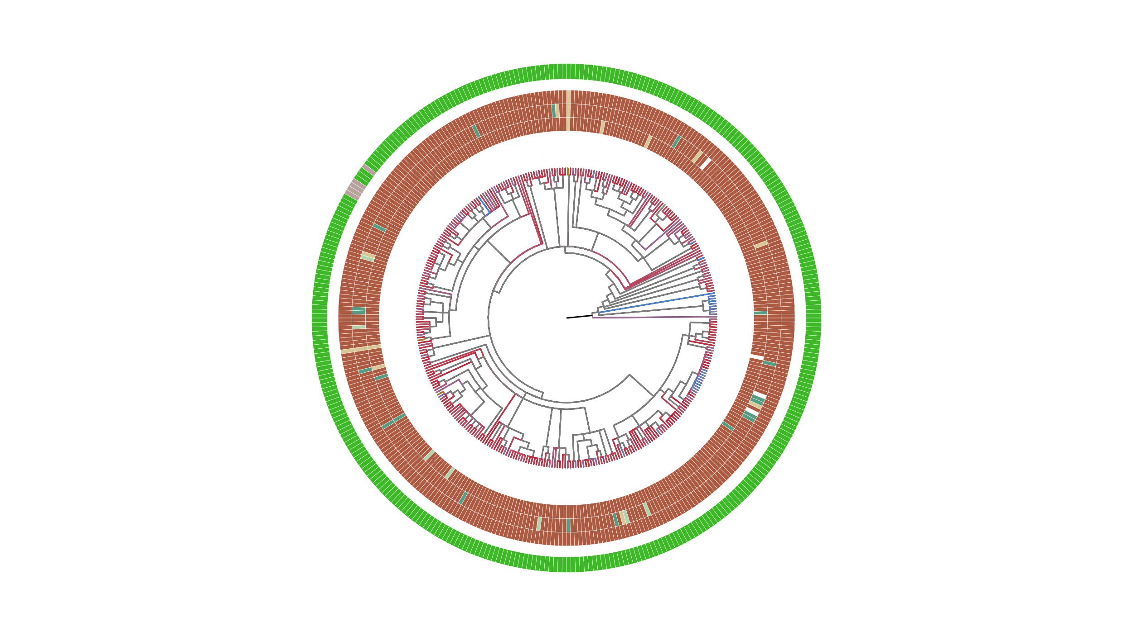
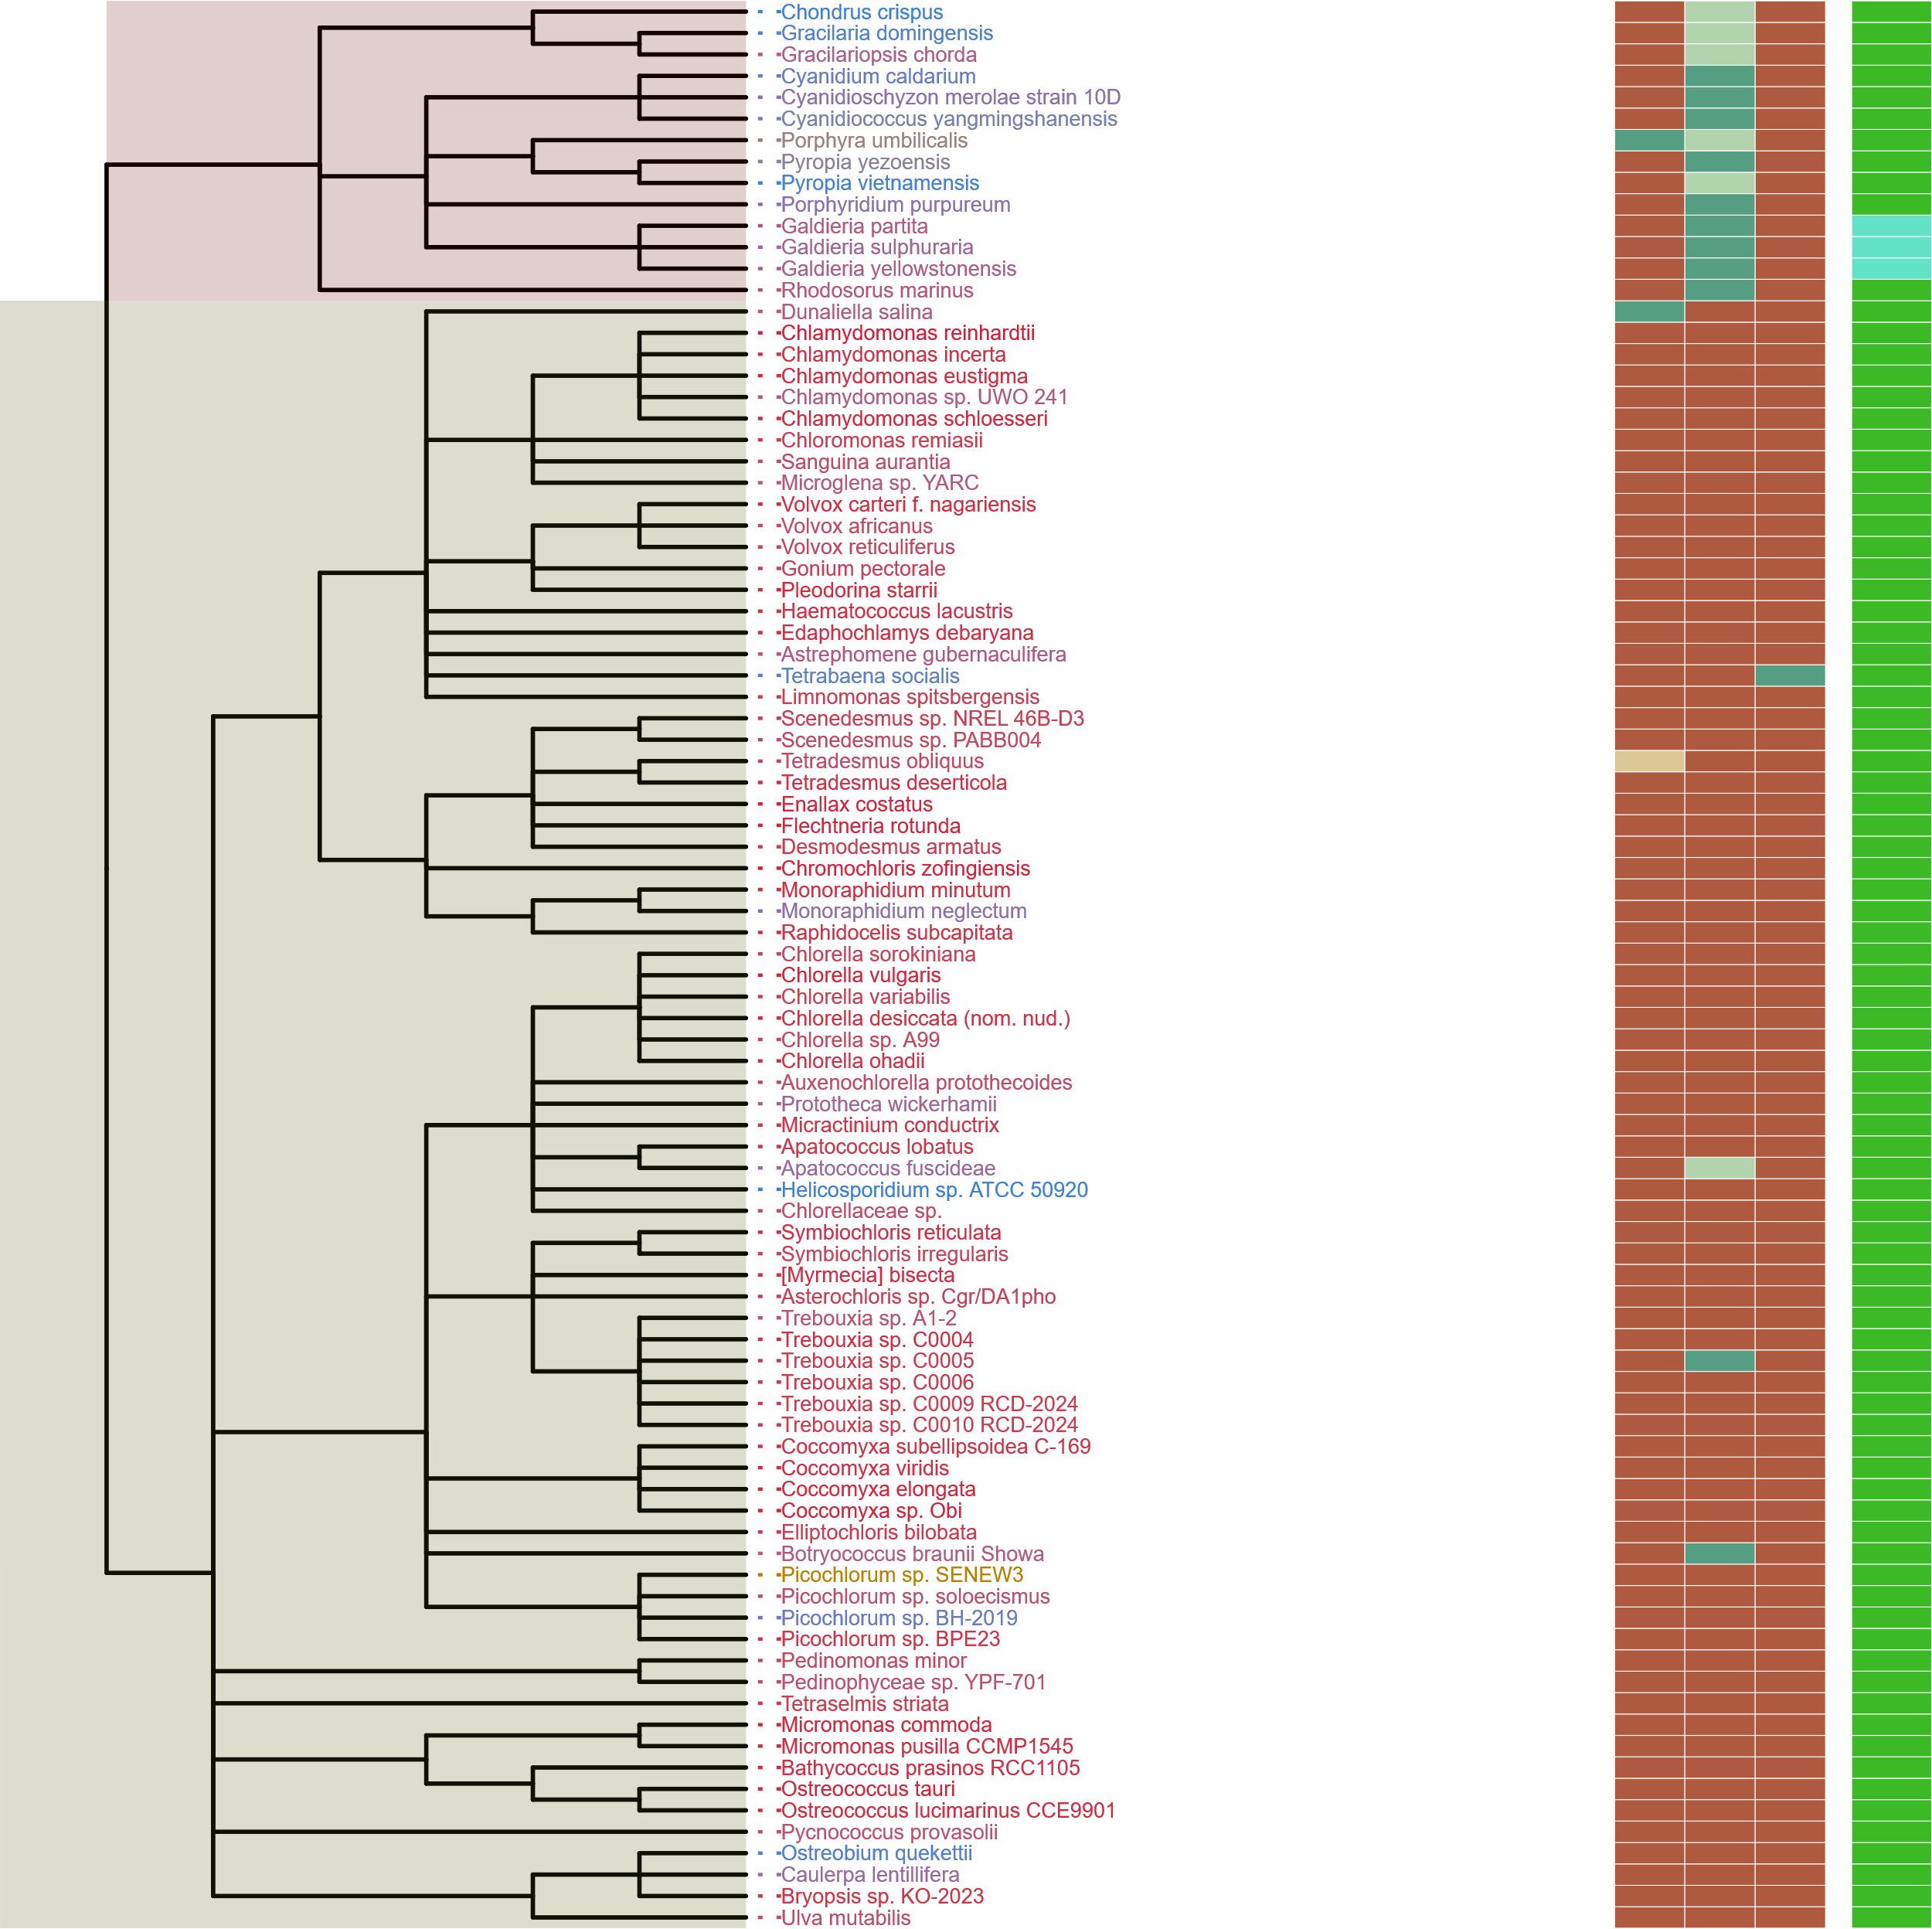
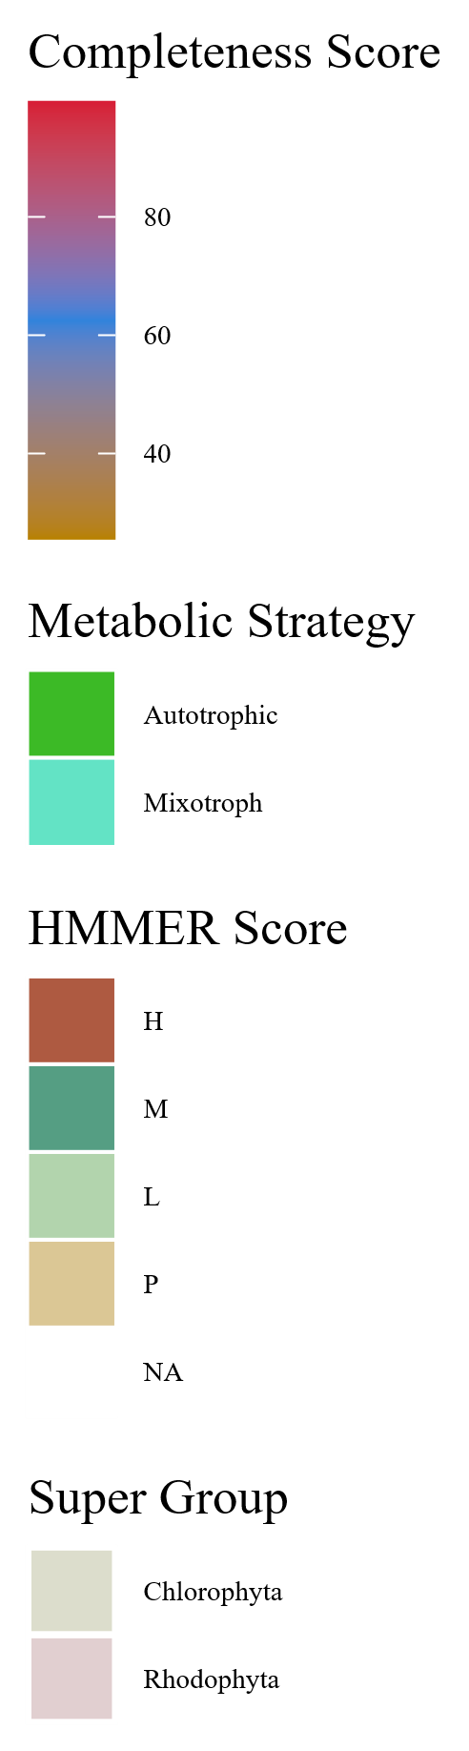
Metabolic Strategy
SIN1
RICTOR
RAPTOR
LST8
TOR
Streptophyta
Rhodophyta
Chlorophyta

Slide 12
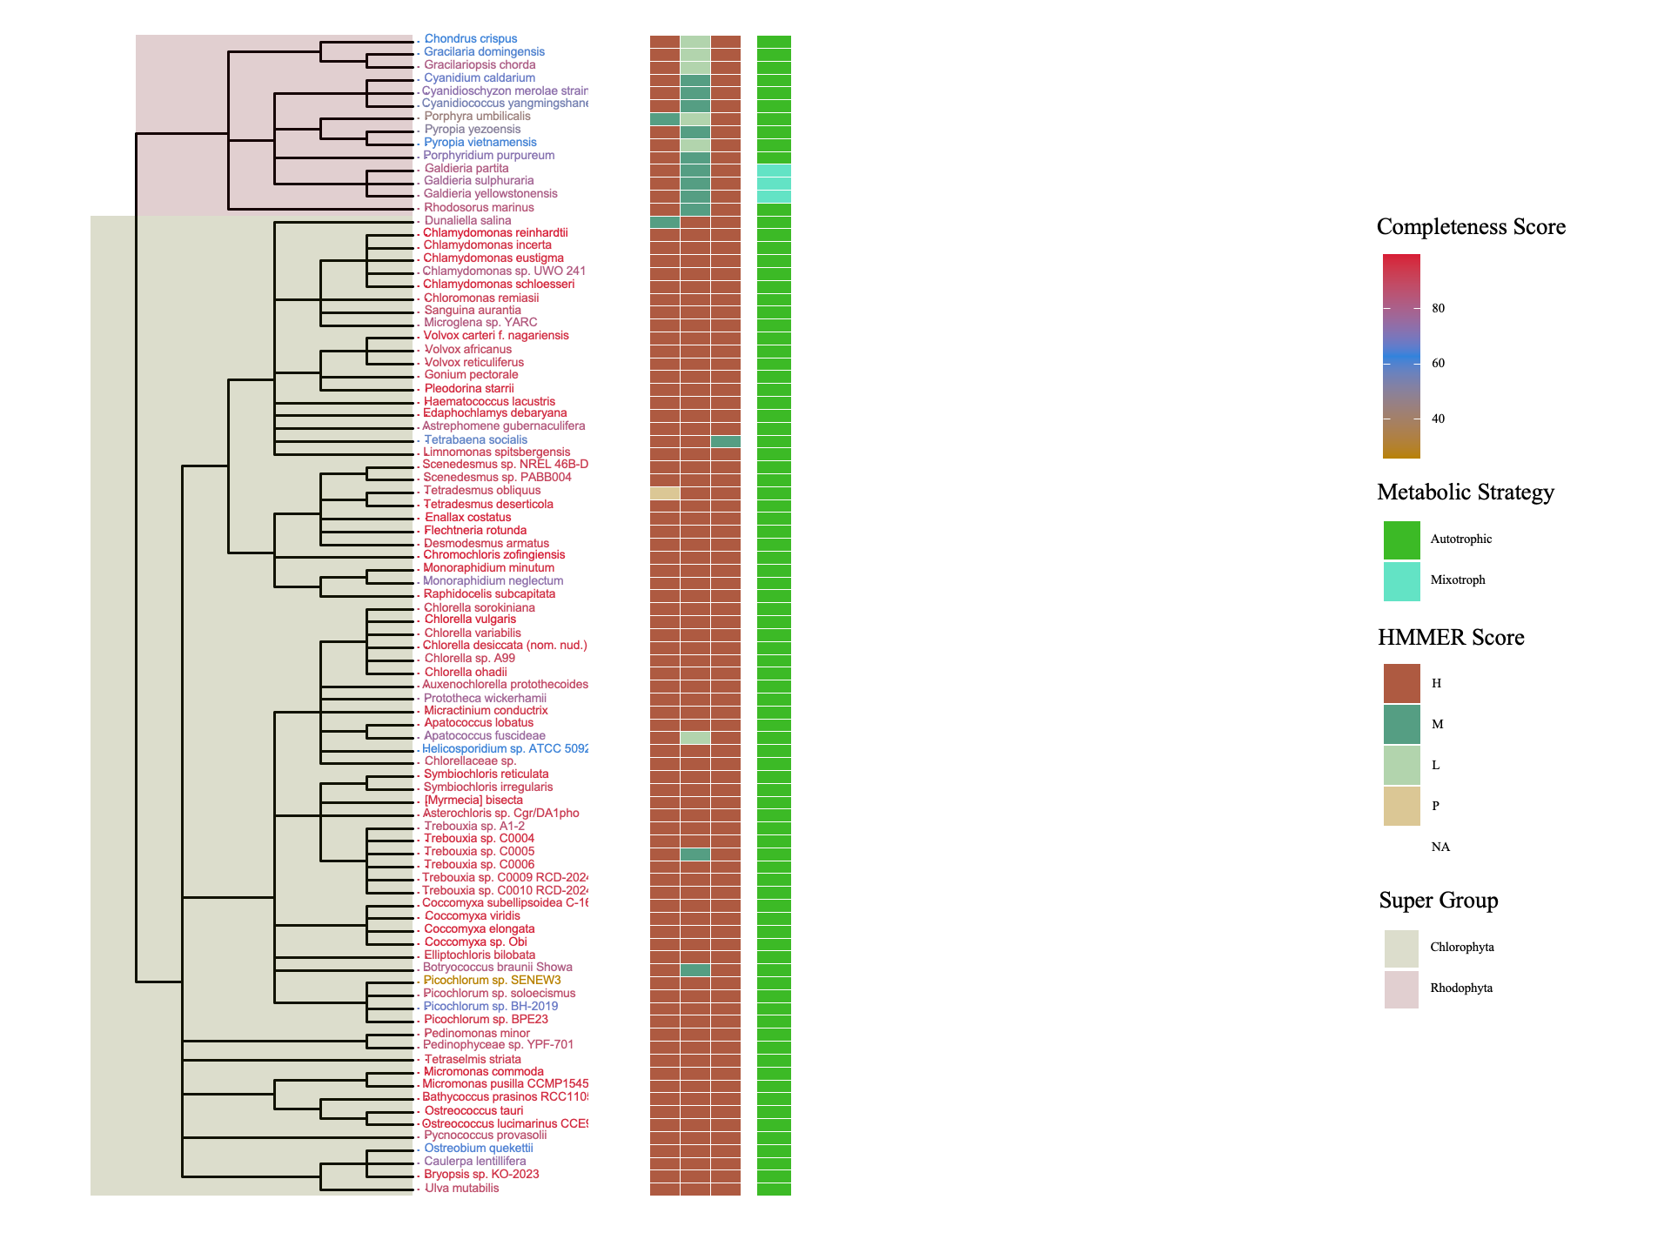
Figure 7
Metabolic Strategy
Metabolic Strategy
SIN1
RICTOR
LST8
RAPTOR
SIN1
TOR
RICTOR
RAPTOR
LST8
TOR
Rhodophyta
Discoba
Chlorophyta
Metamonada

Slide 13
ARCHIVED BELOW

Slide 14
Streptophyta
Secondary Endosymbiosis
Rhodophyta
Primary Endosymbiosis
TORC2
Chlorophyta
Chlorarachniales
TORC1 + TORC2
Rhizaria
TORC1 + TORC2
Primary Endosymbiosis
Archaeplastida
TORC1
LECA
TORC1 + TORC2
Paulinella Micropora
TORC1 + TORC2
SAR
TORC1 +TORC2
Secondary Endosymbiosis
TORC2
Stramenopiles TORC1 + TORC2
Brown Algae
TORC1
Secondary Endosymbiosis
Excavates
TORC1 +TORC2
Tertiary Endosymbiosis
TORC2 + TORC1
Eulena Gracilis
TORC1 + TORC2
Alveolata

Slide 15
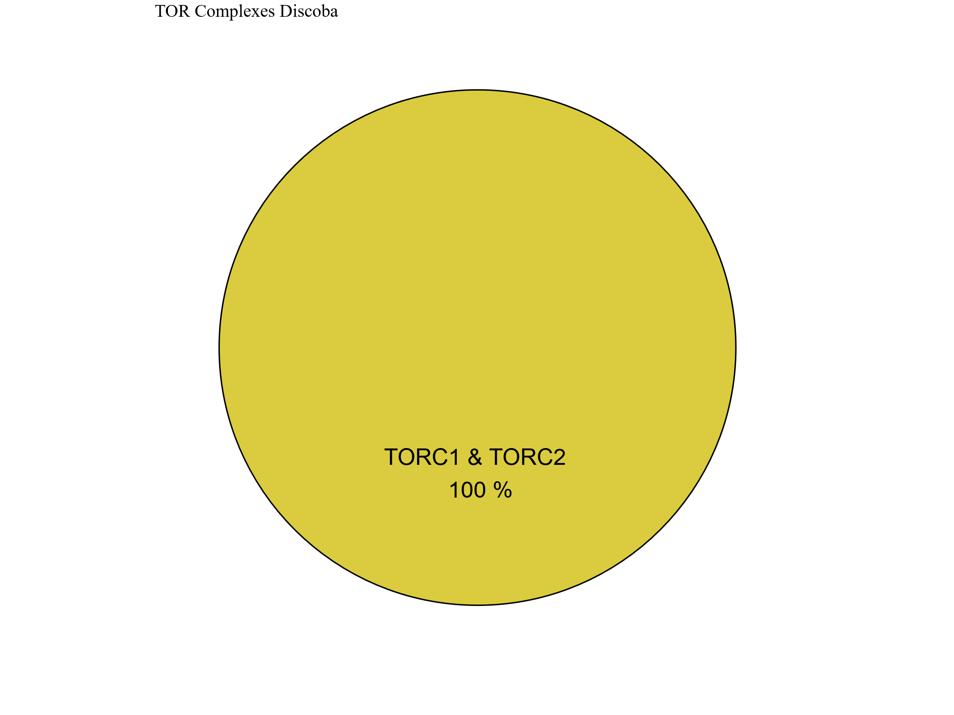
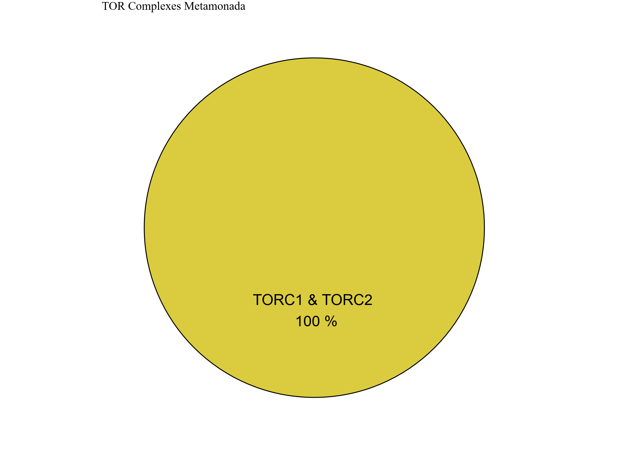
Figure 7
Metabolic Strategy
SIN1
RICTOR
RAPTOR
LST8
TOR
Discoba
Metamonada

Slide 16
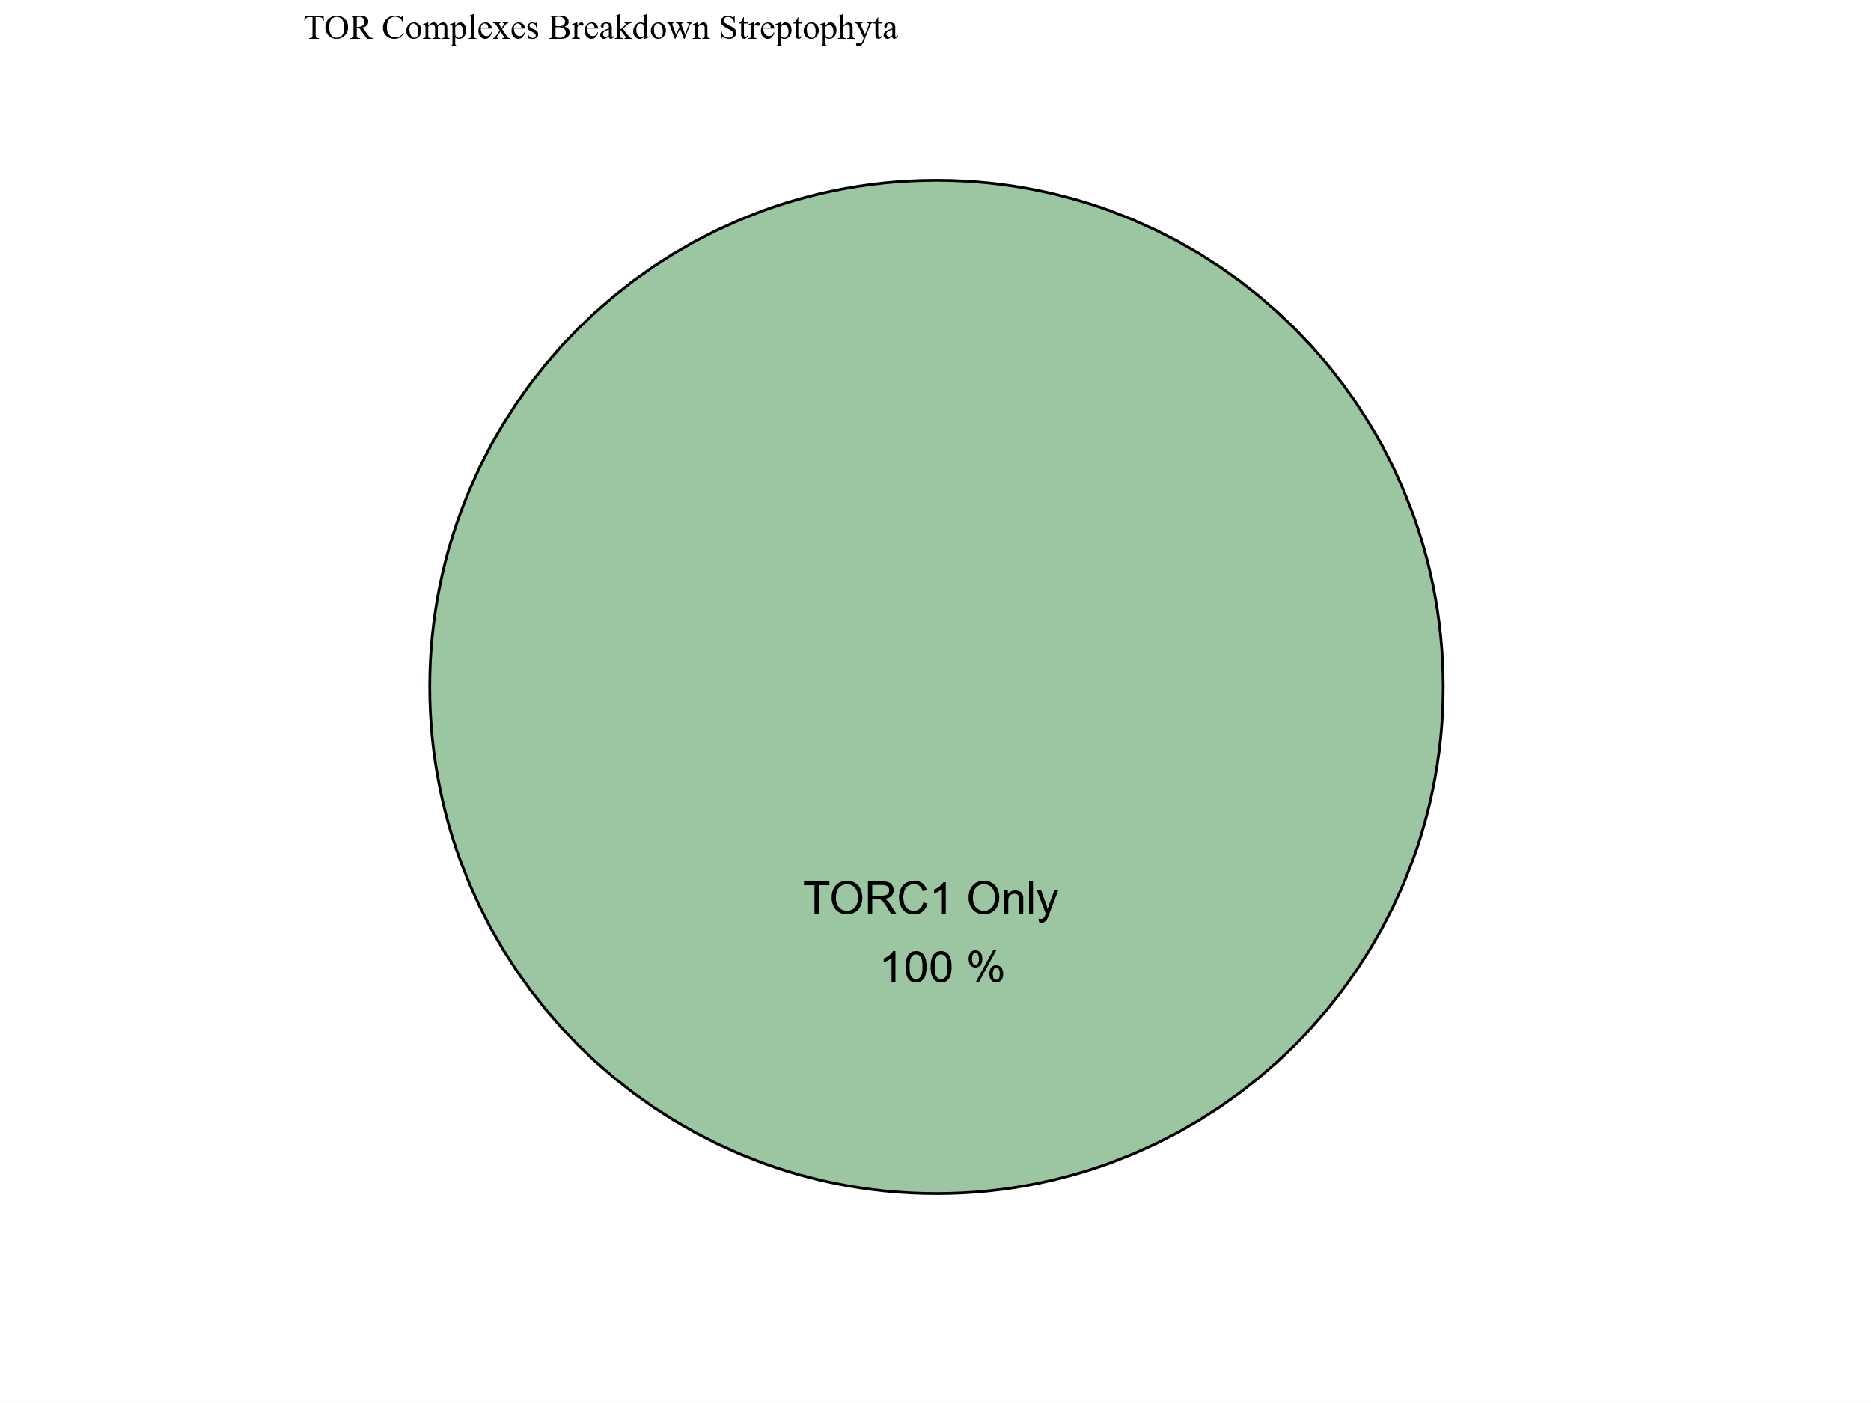
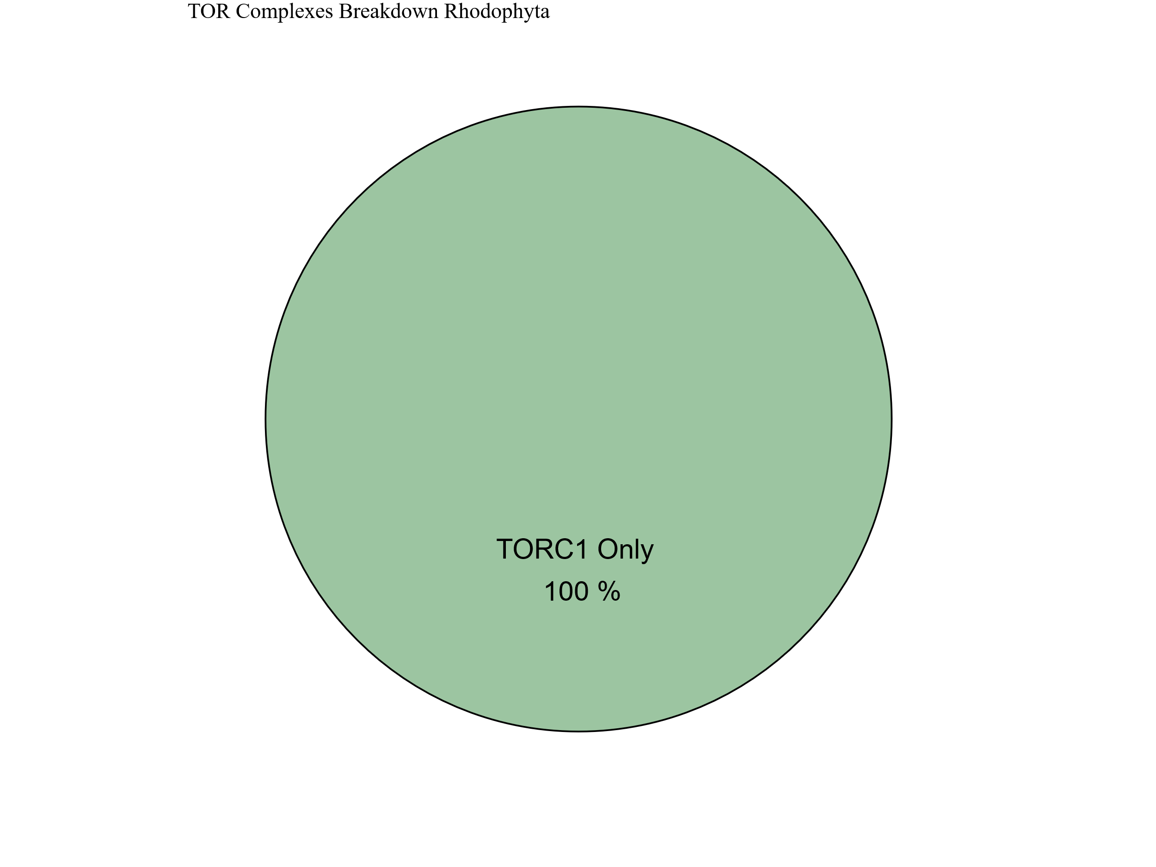
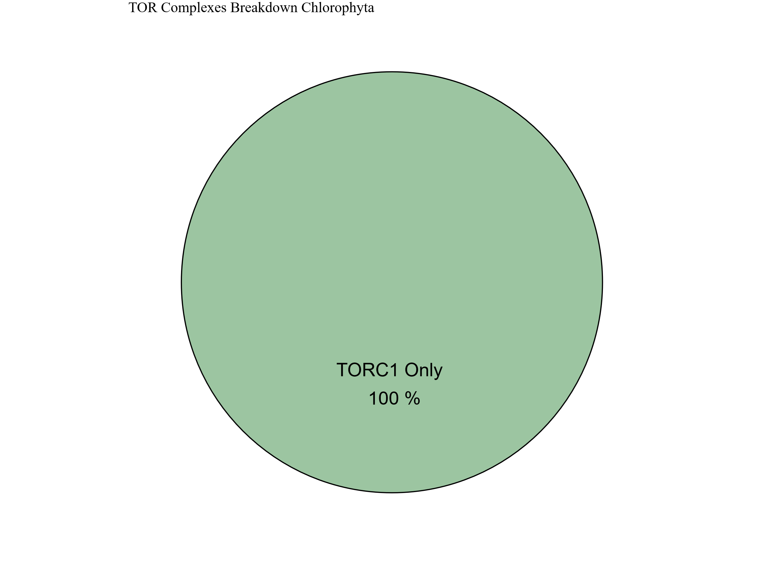
Metabolic Strategy
Streptophyta
SIN1
RICTOR
RAPTOR
LST8
TOR
Rhodophyta
Chlorophyta

Slide 17
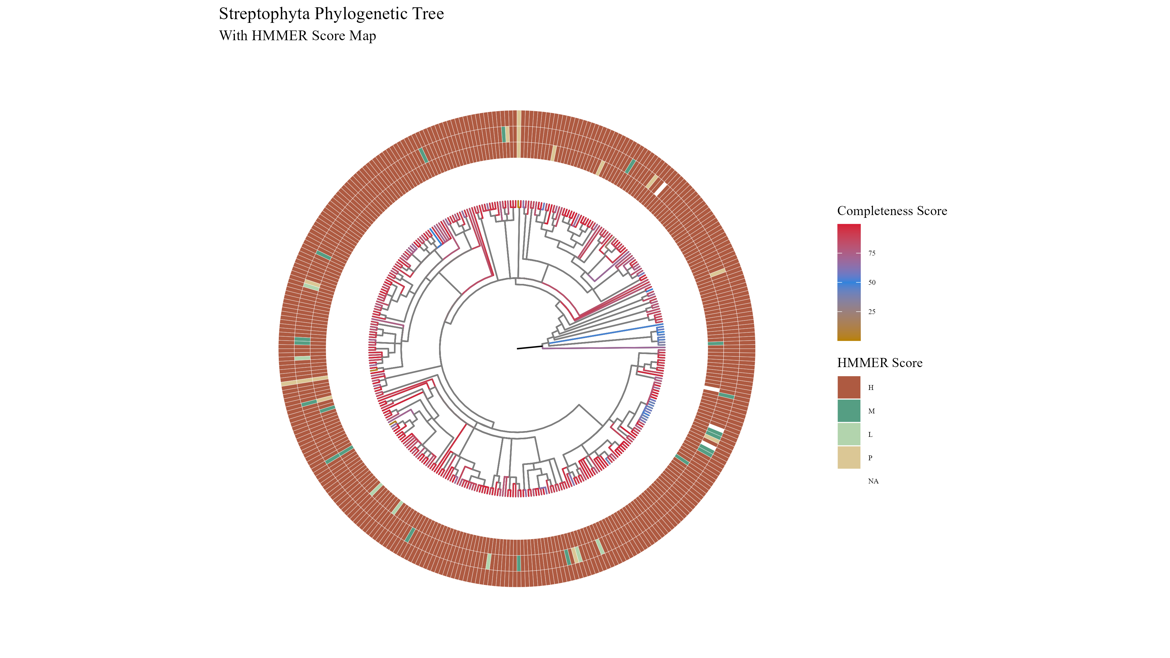
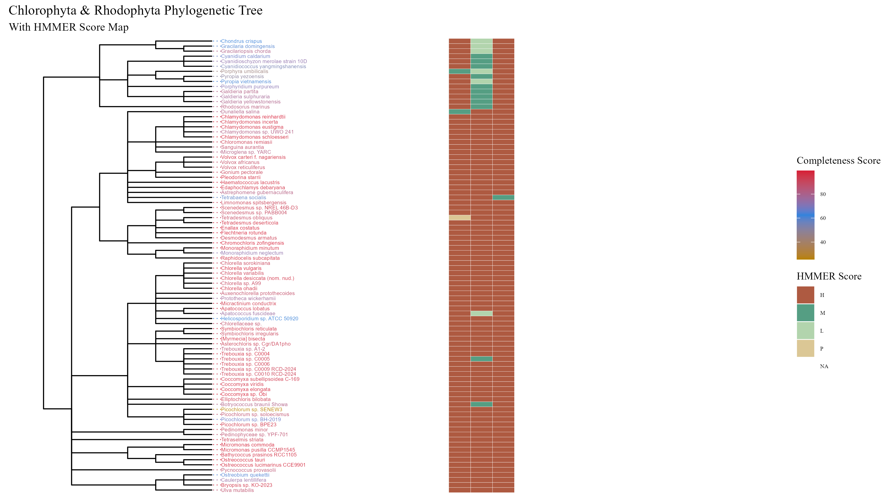

Slide 18





Figure 6

Slide 19


Figure 6

Slide 20



Figure 6

Slide 21
Figure 5

Slide 22
Workflow/Pipeline
NCBI/JGI Genomic Information
MSA
Phylogenetic Tree(s)
Results/TOR Complex Patterns
BUSCO/HMMER/BLAST
R Tables & Taxonomy Tables
Graphs/Data Table
SRA /Diamond Alignment
Notes:
We need to add a start point. Have something that asks the question; what organisms have TORC2 Components and TORC1 Components?

Slide 23
SARs Gain of Plastids:
Losses of TOR Complexes
Rhodophyta Endosymbiosis
Phaeodactylum tricornutum
TORC2 Lost
Macrocystis pyrifera
Stramenopila
Nannochloropsis gaditana
Phytophthora sojae
Expected Heterotrophic Ancestor
TORC1 & TORC2 Present
Stramenopile Endosymbiosis
Polarella glaciallis
Vitrella Brassicaformis
Alveolata
Plasmodium falciparum
Tetrahymena thermophila
Alpha-Cyanobacteria Endosymbiosis
Photoautorophy Loss
Paulinella micropora
TORC1 and TORC2 Lost
Bigelowiella natans
TORC1 Lost
Rhizaria
Chlorophyta Endosymbiosis
Plasmodiophora brassicae

Slide 24
Figure 4

Slide 25


Slide 26


Figure 4

Slide 27
Simplified Excavata Gain of Plastids
Chlorophyta Endosymbiosis
Euglenophyceae
Discoba
Kinetoplastea
Eutetramitia, etc.
Expected Heterotrophic Ancestor
TORC1 & TORC2 Present
Metamonada

Slide 28


Slide 29

Figure 1
Metamonada
Opisthokonta
Amoebozoa
Discoba
Rhizaria
Streptophyta
Alveolata
Stramenopila
Rhodophyta
Chlorophyta

Slide 30




Figure 7

Slide 31




Slide 32
Figure 3

Slide 33




Slide 34


Slide 35


Slide 36


Slide 37

Figure 3
TOR
LST8
RAPTOR
RICTOR
SIN1

Slide 38








Figure 2

Slide 39
Metabolic Strategy
LST8
RICTOR
RAPTOR
SIN1
TOR
Stramenopiles
Alveolata
Rhizaria

